Slide 1




2. Symmetric Key Basics Block or Stream? Secret Key Methods Salting AES: Creation and Modes 3DES
ChaCha20/Poly1305 and RC4 Key Entropy Prof Bill Buchanan OBE https://asecuritysite.com/encryption

Slide 2
Learning outcomes
Understand the conversion of characters between hex, decimal and octal. Sample question: Convert "hello" into a hex stream. Related material: here.
Compute the GCD for values. Sample question: What is the GCD for 42 and 56? Related material: here.
Understand how to manually convert from ASCII to Base-64, and vice-versa. Sample question: What is the Base-64 conversion of “hello”? here.
Understand the concept of key entropy and how it is used to calculate the equivalent key sizes. Sample question: What is the key entropy size for 1,024 pass phrases? Related material: here.
Calculate the time taken to crack a code given a time to try each key, and for the number of processing elements. Sample question: If it takes 100 years to crack a cipher code, and computing power doubles each year. How long will it take to crack a code after five years?

Slide 3
Learning outcomes
Understand the features of differing encryption methods such as AES, DES, 3DES and PGP. Sample question: How does 3-DES differ from DES when encrypting data?
Understand the differences between stream and block ciphers.
Able to identify key hash types such as MD5, SHA-1 and LM. Sample question: Which type of hashing method has been used for a hash code of “5D41402ABC4B2A76B9719D911017C592”? Related material: here.
Understand how passwords are stored and the weaknesses of these methods. Sample: What methods might an intruder use to determine the passwords on a system, giving the hashed values of the passwords?
Understand the range of tools which could be used to crack hashes, such as for MD5, LM and NTLM. Sample question: Give an example of a Kali Linux tools that could be used to crack LM, and outline its operation? Related material: here.
Define the salting process for passwords. Sample question: What are the key advantages of using a salt value for a password?

Slide 4
Learning outcomes
Explain how public key provides both privacy and identity verification.
Understand how the RSA process works, with a simple example.
Understand how the Elliptic Curve process works, with a simple example.
Understand how the Diffie-Hellman process works, with a simple example.
Understand how the Elliptic Curve Diffie Hellman works, with a simple example.
Public key: Understands how the private key is used to check the identity of the sender, and how public key is used to preserve the privacy of the message.
Public key: Explain how the e and d values are determined within the RSA method. Where would I find this info? There are some examples here.
Understand the full process used for providing privacy and identity within public key encryption. Sample question: Explain the public key encryption process. Related material: here.
Define the process used in public key encryption, including the generation of the keys and the calculation of the cipher message. Sample question: If two prime numbers of 3 and 5 are selected, what are the values for N and PHI? Related material: here.

Slide 5
Learning outcomes
Understand the methods used for the Diffie-Hellman method. Sample: Outline the process of how hosts use the Diffie-Hellman method, in order to generate a share secret key. here.
Understand how the Diffie-Hellman process works, with a simple example.
Understand how the Elliptic Curve Diffie Hellman works, with a simple example.

Slide 6
2. Symmetric Key Basics Block or Stream? Secret Key Methods Salting AES: Creation and Modes 3DES
ChaCha20/Poly1305 and RC4 Key Entropy Prof Bill Buchanan OBE https://asecuritysite.com/symmetric

Slide 7
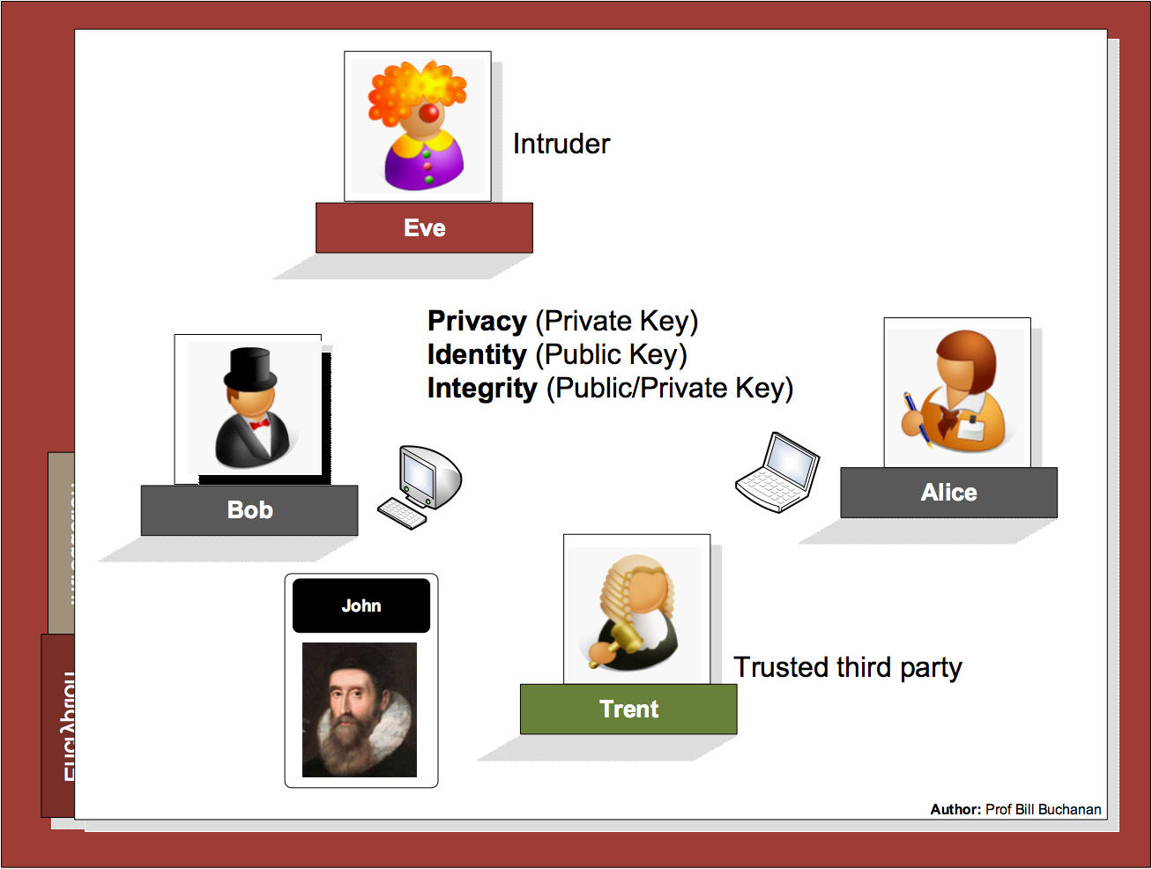

Slide 8
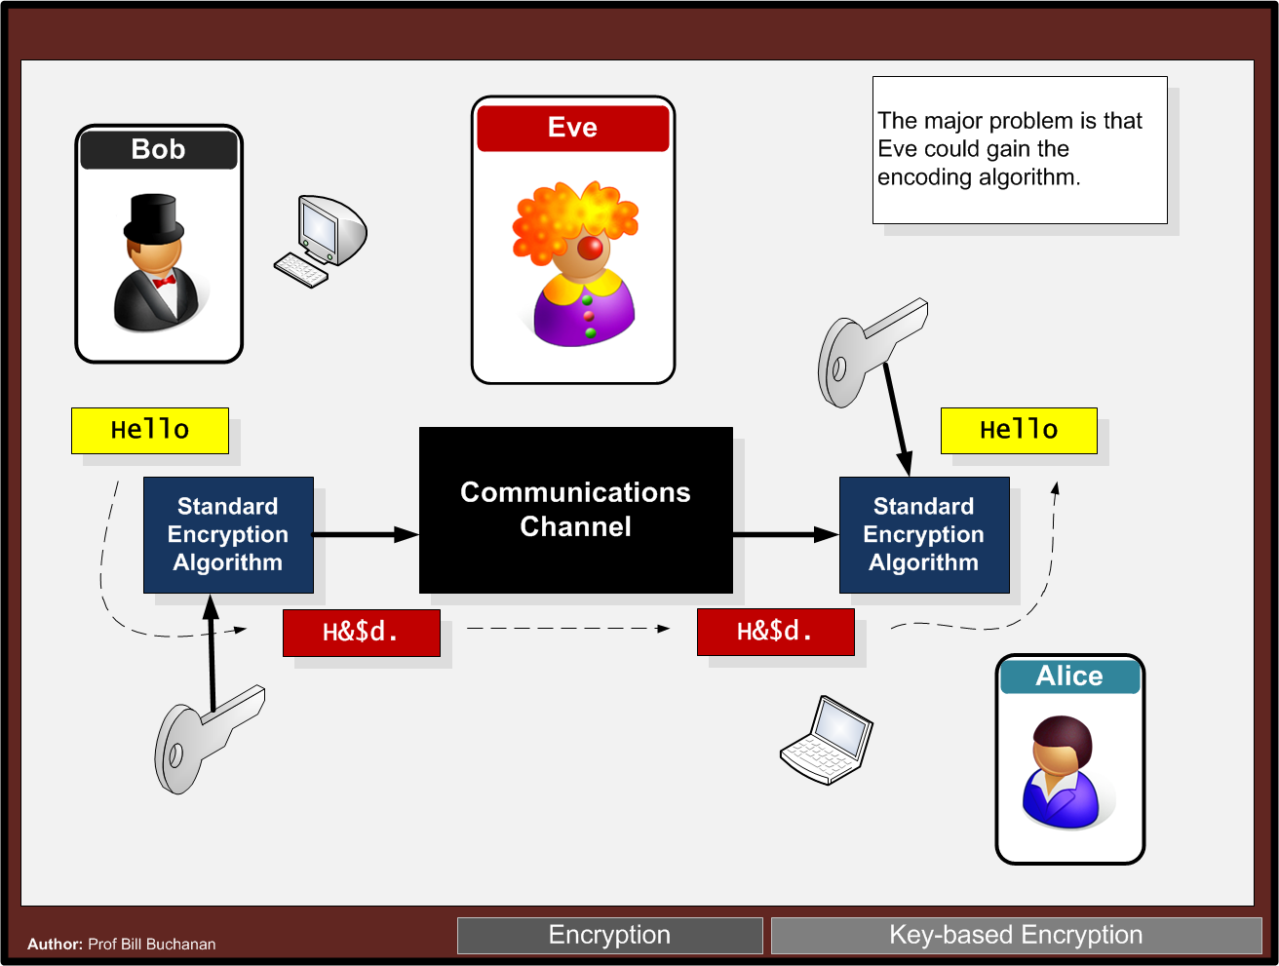

Slide 9
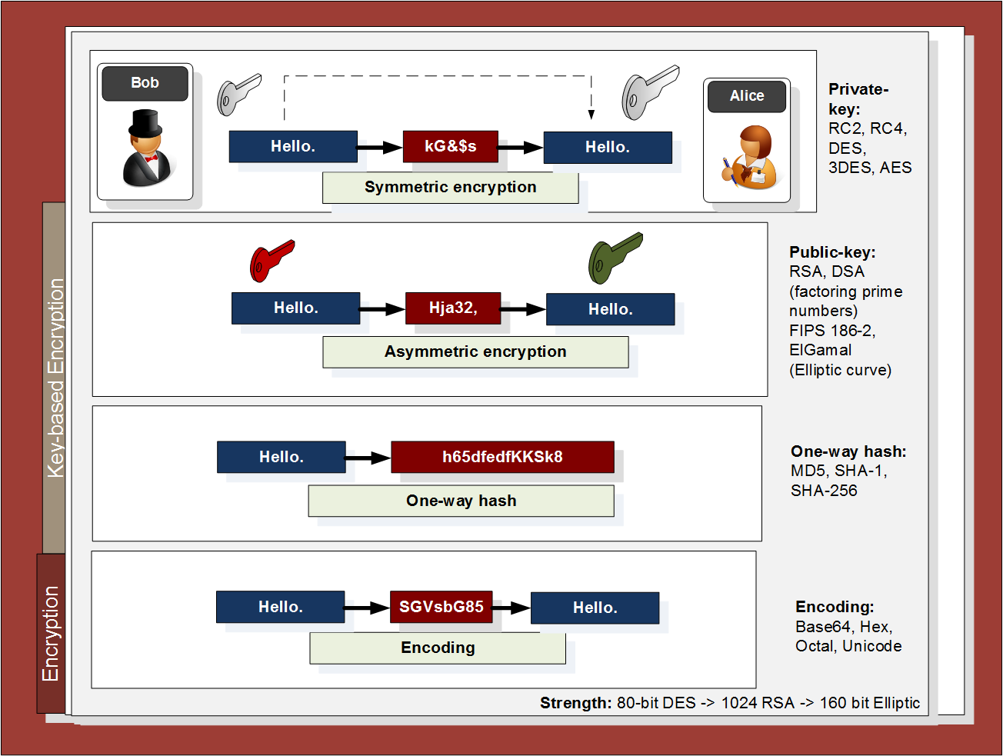

Slide 10
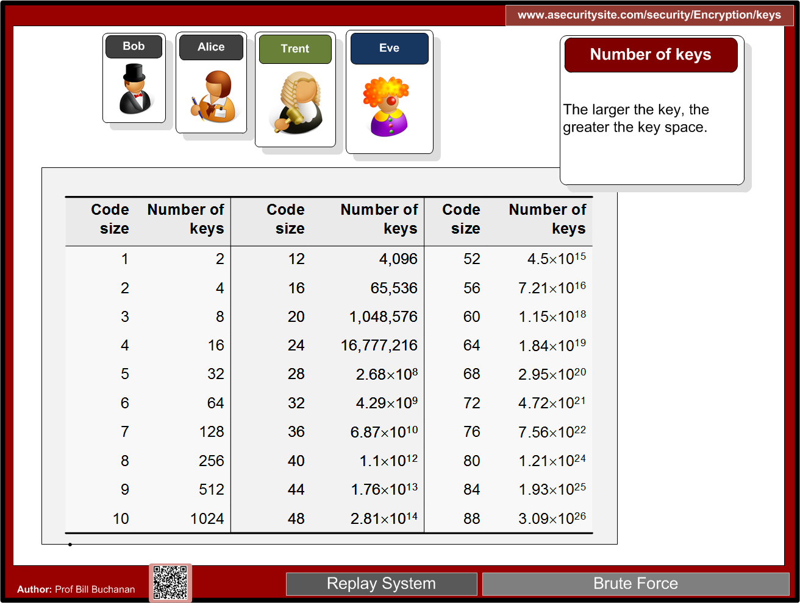

Slide 11
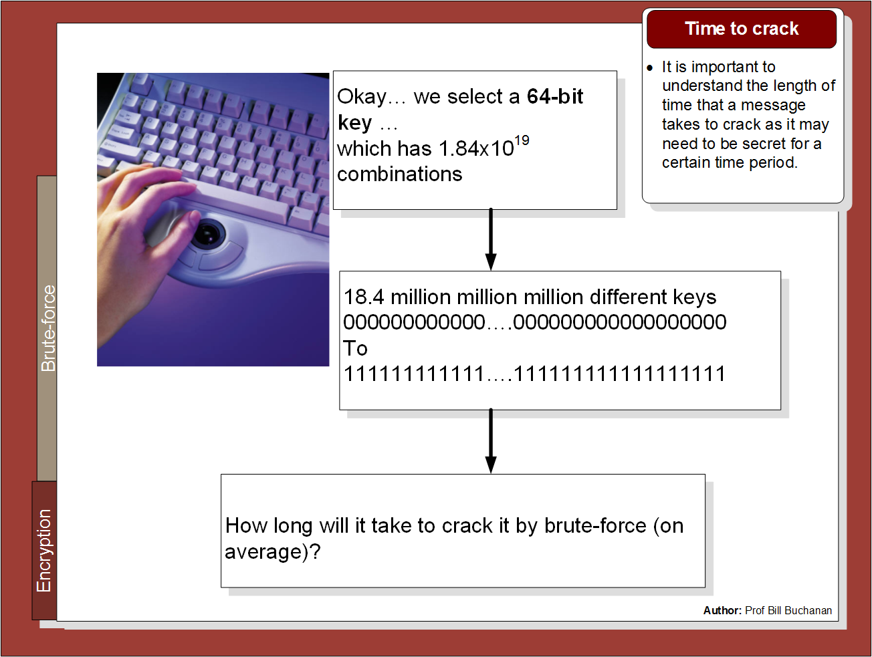

Slide 12
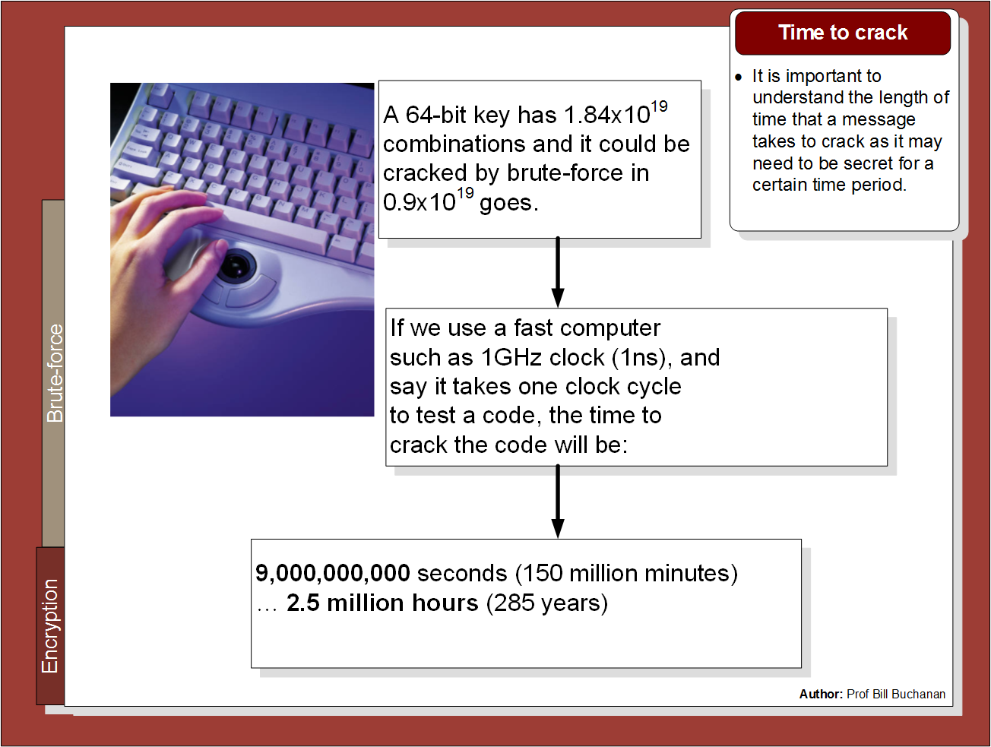

Slide 13
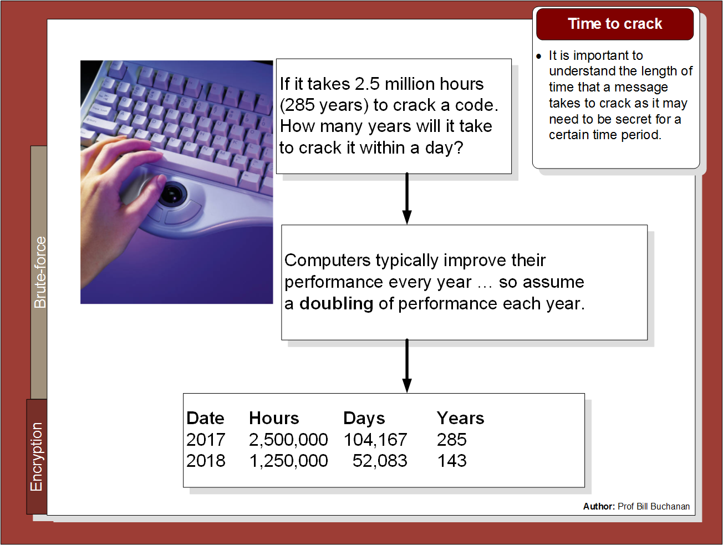

Slide 14
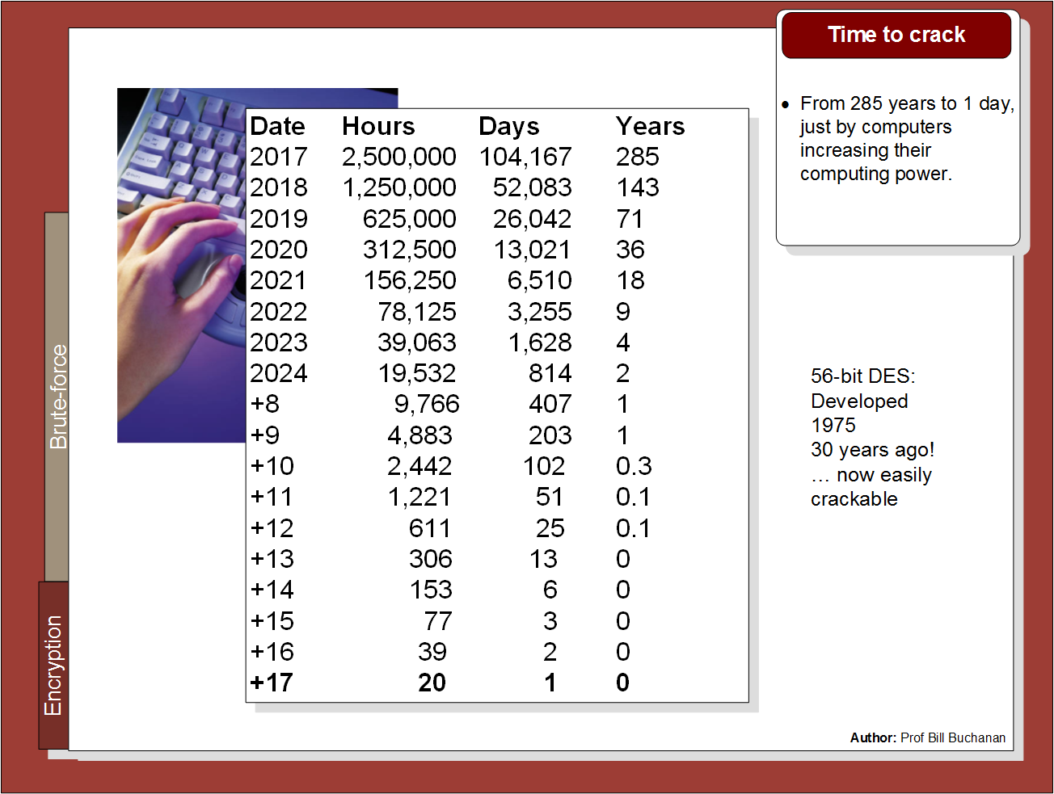

Slide 15
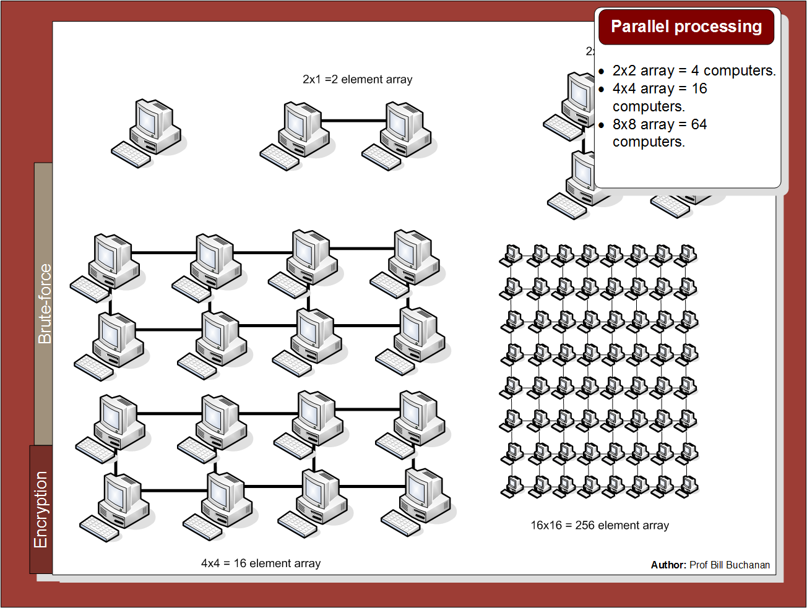

Slide 16
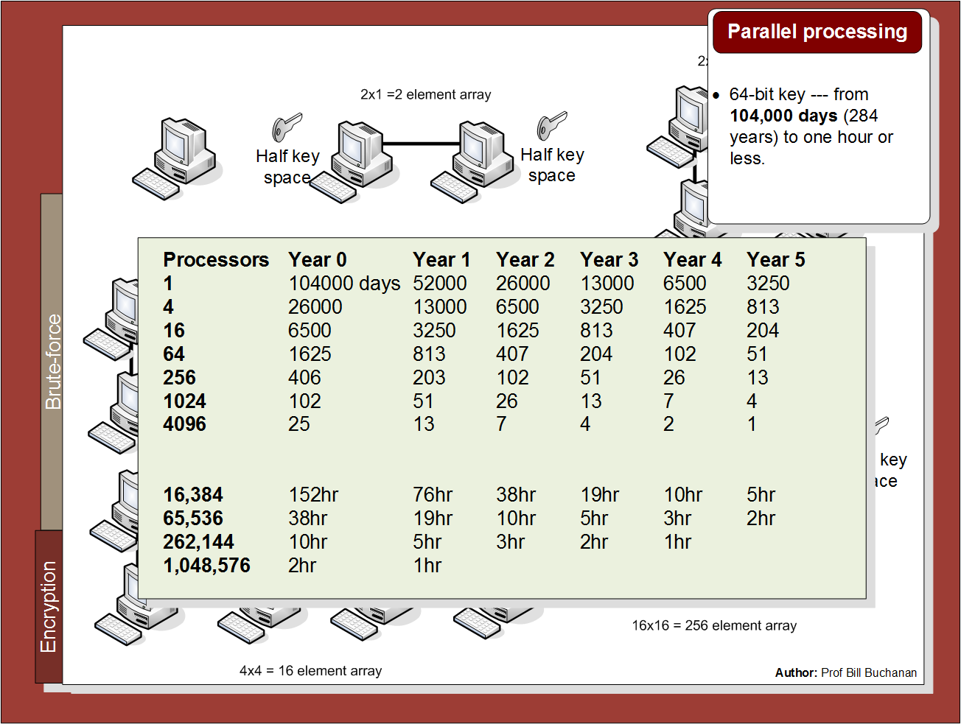

Slide 17
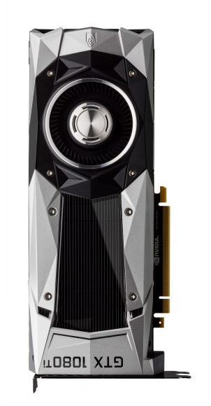
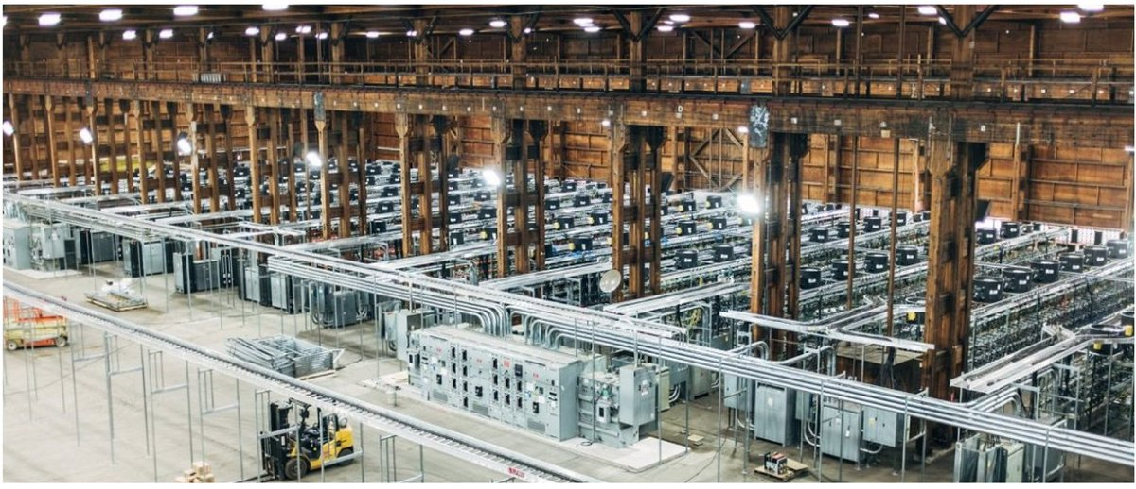
Nvidia GeForce GTX 1080 Ti Specifications: – Graphics Processing Clusters: 6 – Streaming Multiprocessors: 28 – CUDA Cores (single precision): 3584 – Texture Units: 224 – ROP Units: 88 – Base Clock: 1480 MHz – Boost Clock: 1582 MHz – Memory Clock: 5505 MHz – Memory Data Rate: 11 Gbps – L2 Cache Size: 2816K – Total Video Memory: 11264MB GDDR5X – Memory Interface: 352-bit – Total Memory Bandwidth: 484 GB/s – Texture Rate (Bilinear): 331.5 GigaTexels/sec – Fabrication Process: 16 nm – Transistor Count: 12 Billion – Connectors: 3 x DisplayPort, 1 x HDMI – Power Connectors: One 6-pin, One 8-pin – Recommended Power Supply: 600 Watts

Slide 18
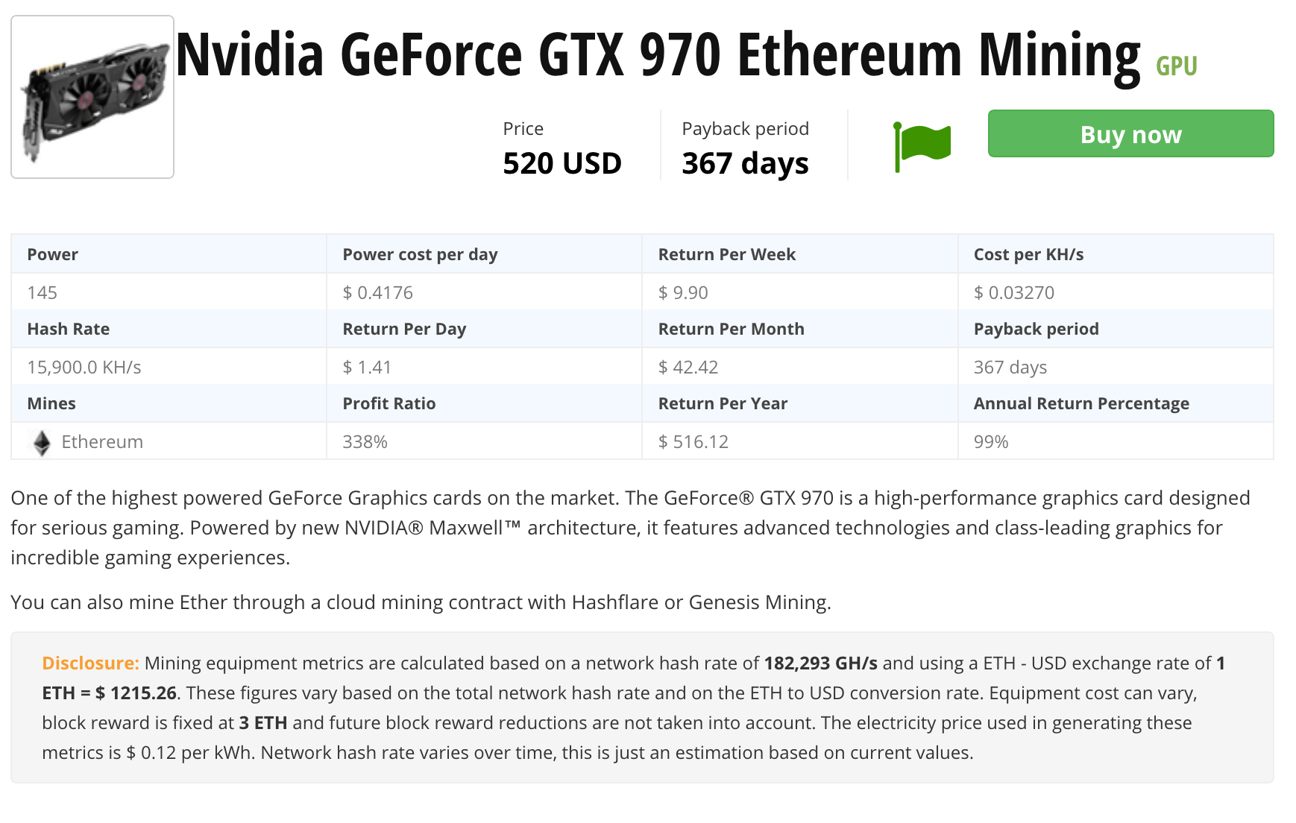


Slide 19
2. Symmetric Key Basics Block or Stream? Secret Key Methods Salting AES 3DES
ChaCha20/Poly1305 and RC4 Key Entropy Prof Bill Buchanan OBE https://asecuritysite.com/symmetric

Slide 20
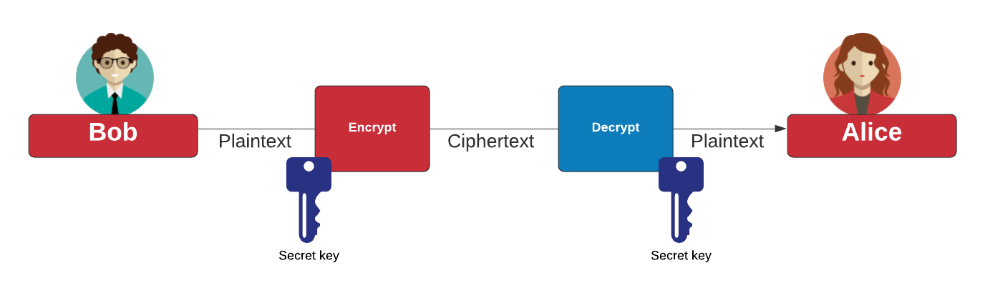
Symmetric Key

Slide 21
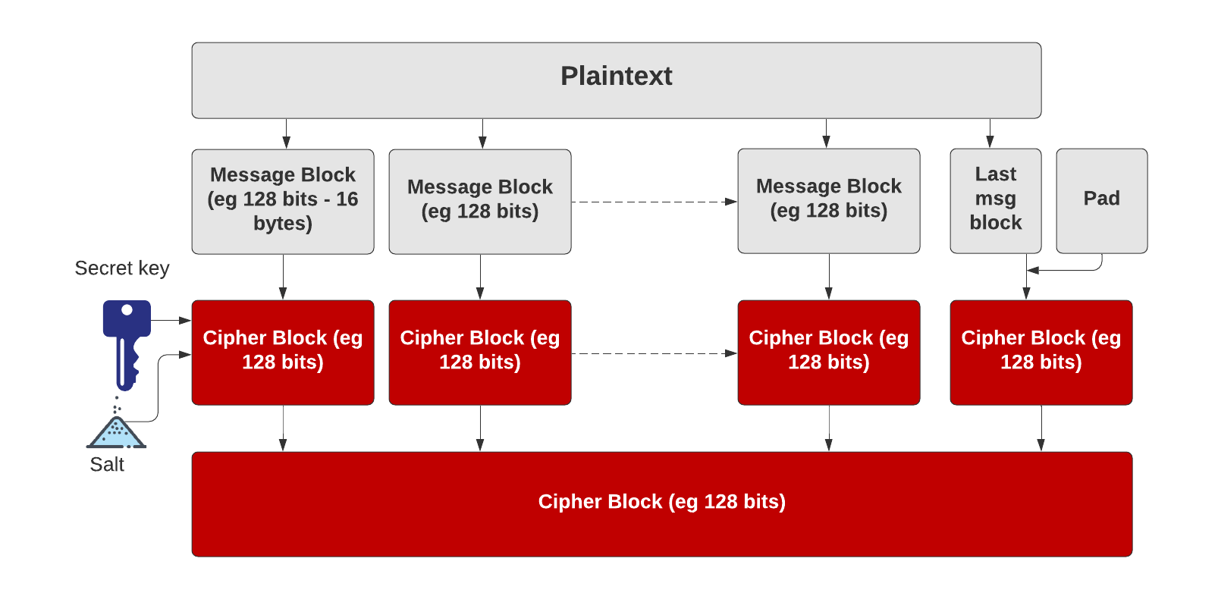
Symmetric Key – Block cipher
https://asecuritysite.com/golang/go_pad

Slide 22
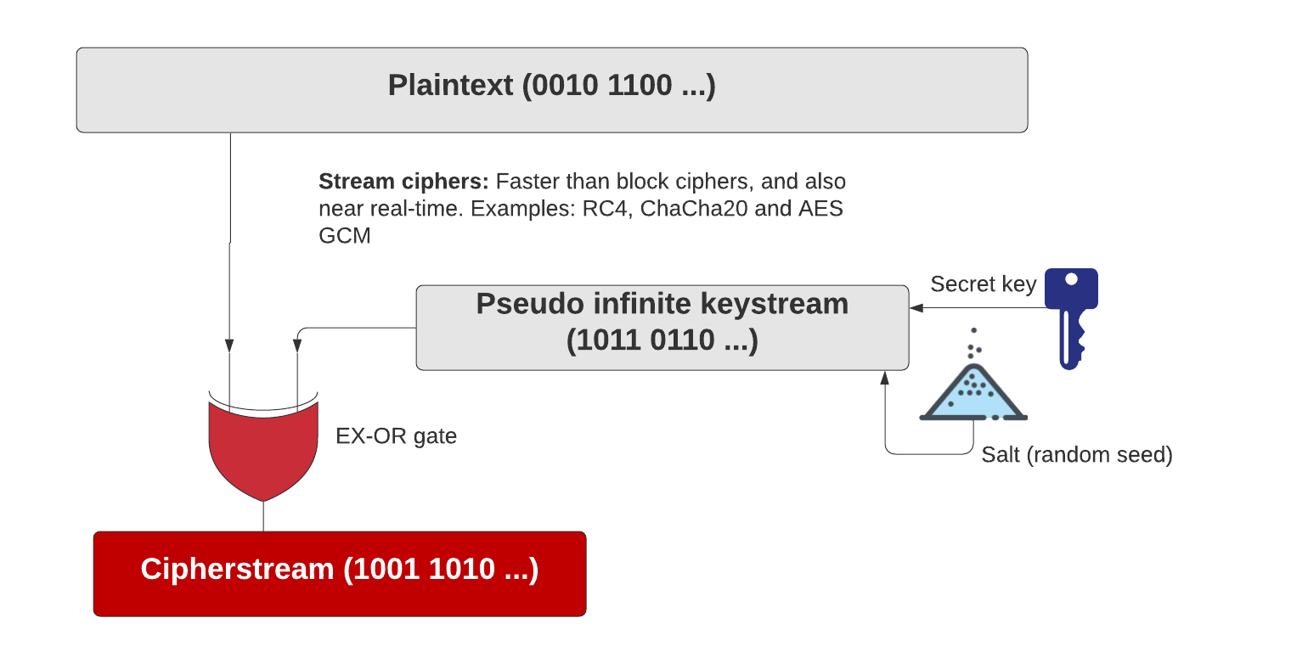
Symmetric Key – Stream cipher
https://asecuritysite.com/golang/go_chacha

Slide 23
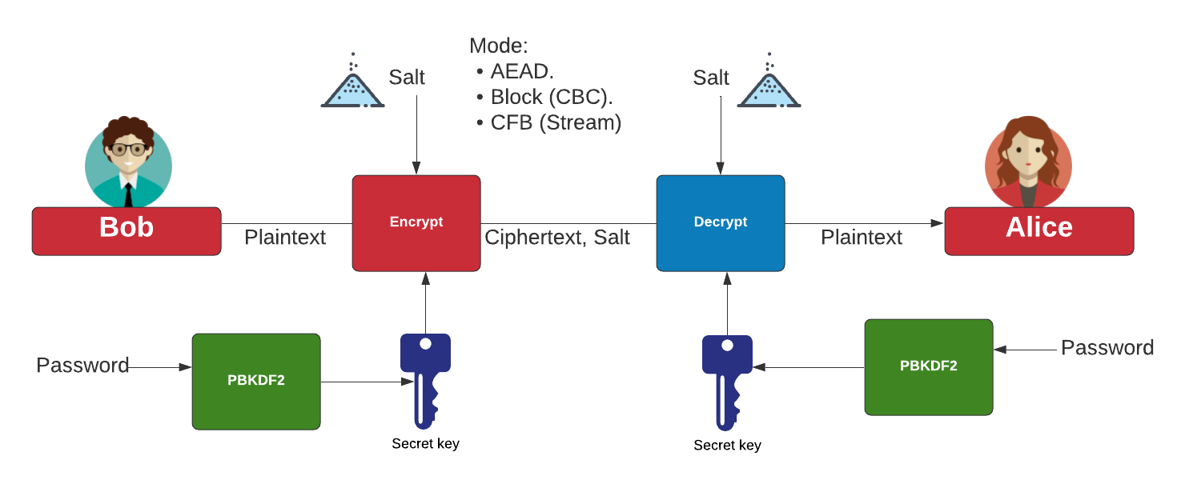
Symmetric Key - Modes
AES Block cipher modes: ECB (No salt), CBC (Cipher Block Chaining).
AES Stream modes: CFB (Cipher Feedback), OFB (Output Feedback), CTR (Counter), GCM (Galois Counter Mode).
https://asecuritysite.com/golang/go_symmetric

Slide 24
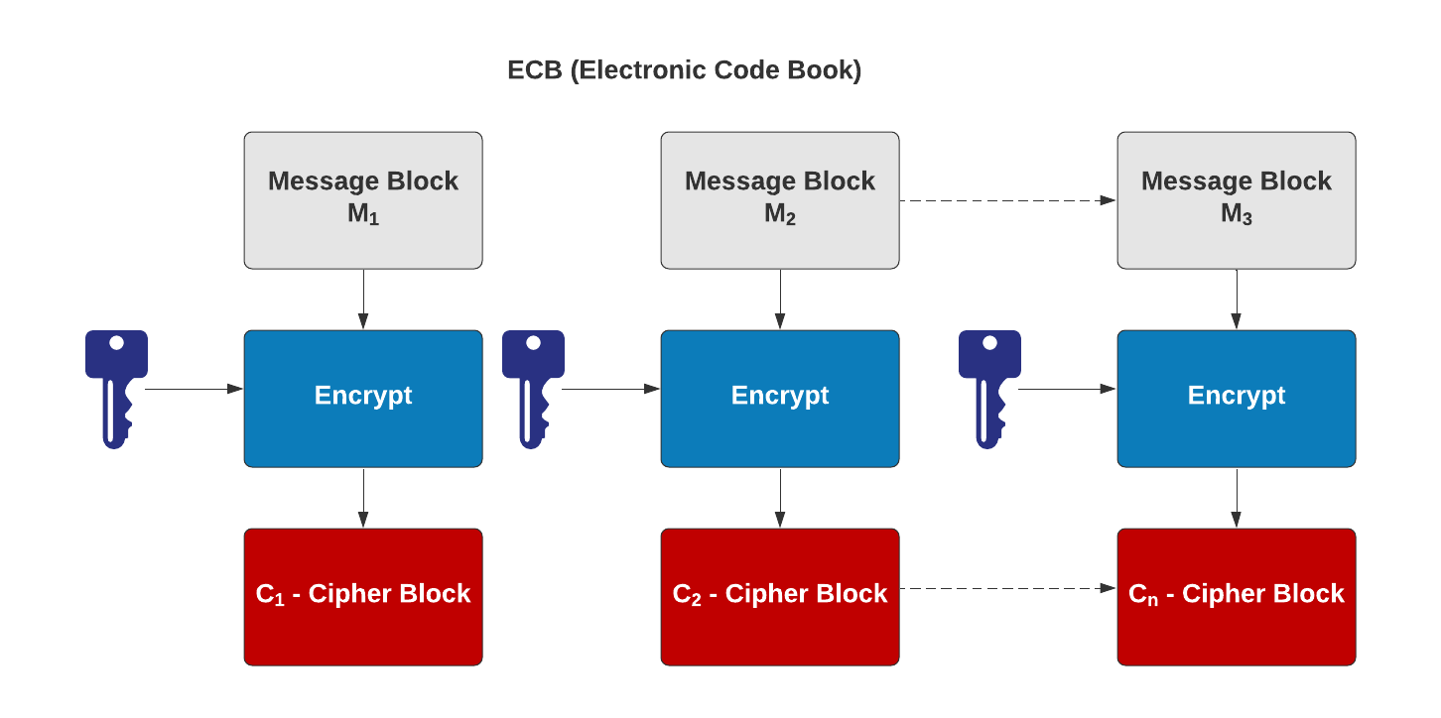
Symmetric Key – Electronic Code Code (ECB)
AES Block cipher modes: ECB (No salt), CBC (Cipher Block Chaining).
AES Stream modes: CFB (Cipher Feedback), OFB (Output Feedback), CTR (Counter), GCM (Galois Counter Mode).
https://asecuritysite.com/golang/go_symmetric

Slide 25
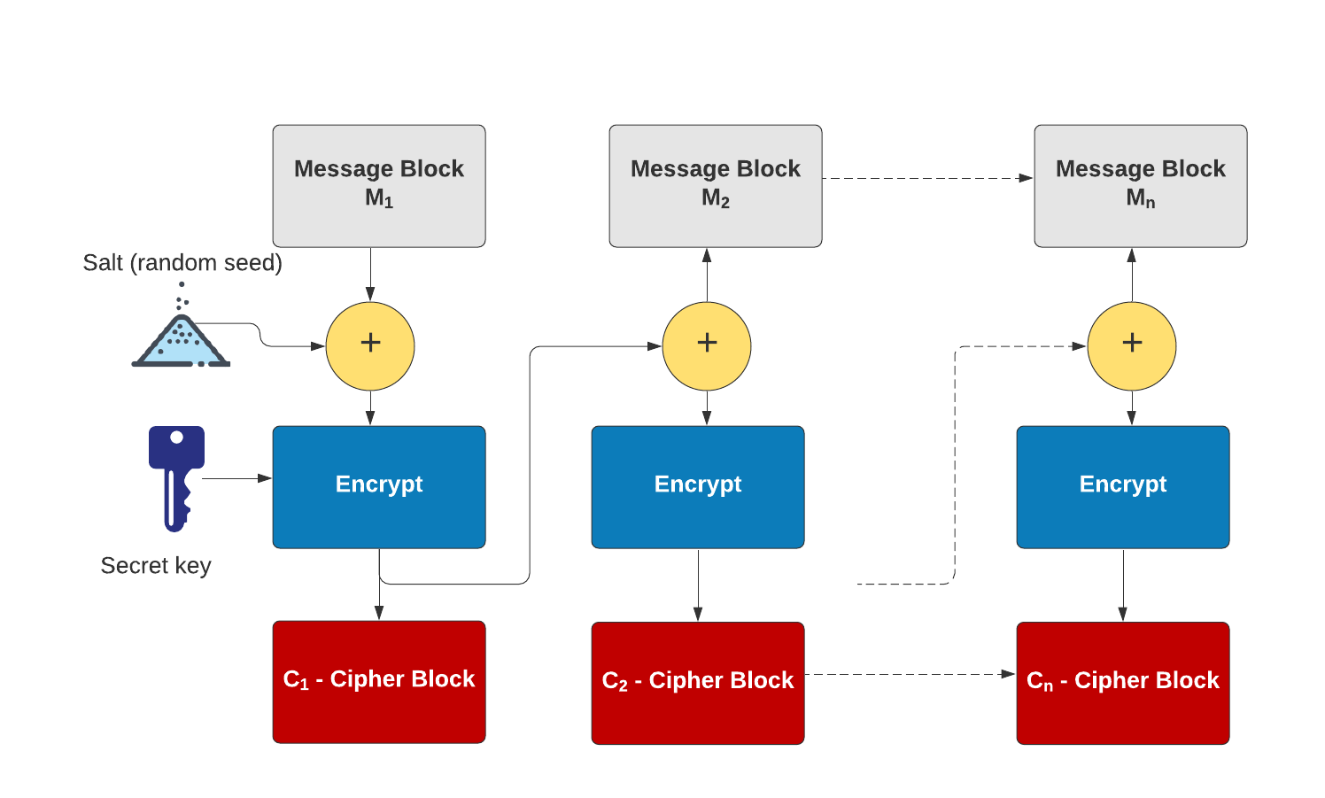
Symmetric Key – Cipher Block Chaining (CBC)
AES Block cipher modes: ECB (No salt), CBC (Cipher Block Chaining).
AES Stream modes: CFB (Cipher Feedback), OFB (Output Feedback), CTR (Counter), GCM (Galois Counter Mode).
https://asecuritysite.com/golang/go_symmetric

Slide 26
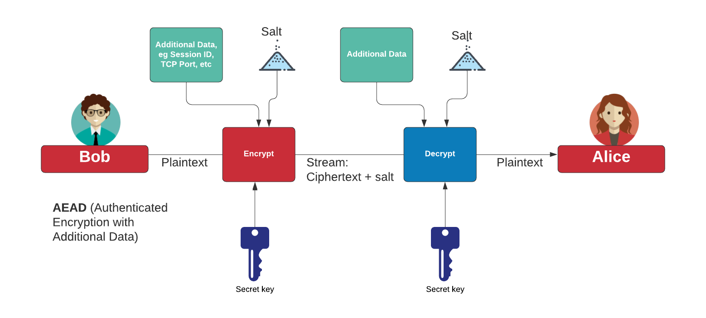
Authenticated Encryption with Additional Data (AEAD)
AES Block cipher modes: ECB (No salt), CBC (Cipher Block Chaining).
AES Stream modes: CFB (Cipher Feedback), OFB (Output Feedback), CTR (Counter), GCM (Galois Counter Mode).
https://asecuritysite.com/golang/go_symmetric

Slide 27
Padding
CMS (Cryptographic Message Syntax). This pads with the same value as the number of padding bytes. Defined in RFC 5652, PKCS#5, PKCS#7 and RFC 1423 PEM.
Bits. This pads with 0x80 (10000000) followed by zero (null) bytes. Defined in ANSI X.923 and ISO/IEC 9797-1.
ZeroLength. This pads with zeros except for the last byte which is equal to the number (length) of padding bytes.
Null. This pads will NULL bytes. This is only used with ASCII text.
Space. This pads with spaces. This is only used with ASCII text.
Random. This pads with random bytes with the last byte defined by the number of padding bytes.

Slide 28
Padding
After padding (CMS): 68656c6c6f0b0b0b0b0b0b0b0b0b0b0b Cipher (ECB): 0a7ec77951291795bac6690c9e7f4c0d
After padding (Bit): 68656c6c6f8000000000000000000000 Cipher (ECB): 731abffc2e3b2c2b5caa9ca2339344f9
After padding (ZeroLen): 68656c6c6f000000000000000000000a Cipher (ECB): d28e2f7e8e44e068732b292bde444245
After padding (Null): 68656c6c6f0000000000000000000000 Cipher (ECB): 444797422460453d95856eb2a1520ece
After padding (Random): 68656c6c6ffc6ecfd884a38798d62a0a Cipher (ECB): c2c88b4364d2c2dc6f2cac9ab73c995d

Slide 29
2. Symmetric Key Basics Block or Stream? Secret Key Methods Salting AES 3DES
ChaCha20/Poly1305 Key Entropy Prof Bill Buchanan OBE https://asecuritysite.com/encryption

Slide 30
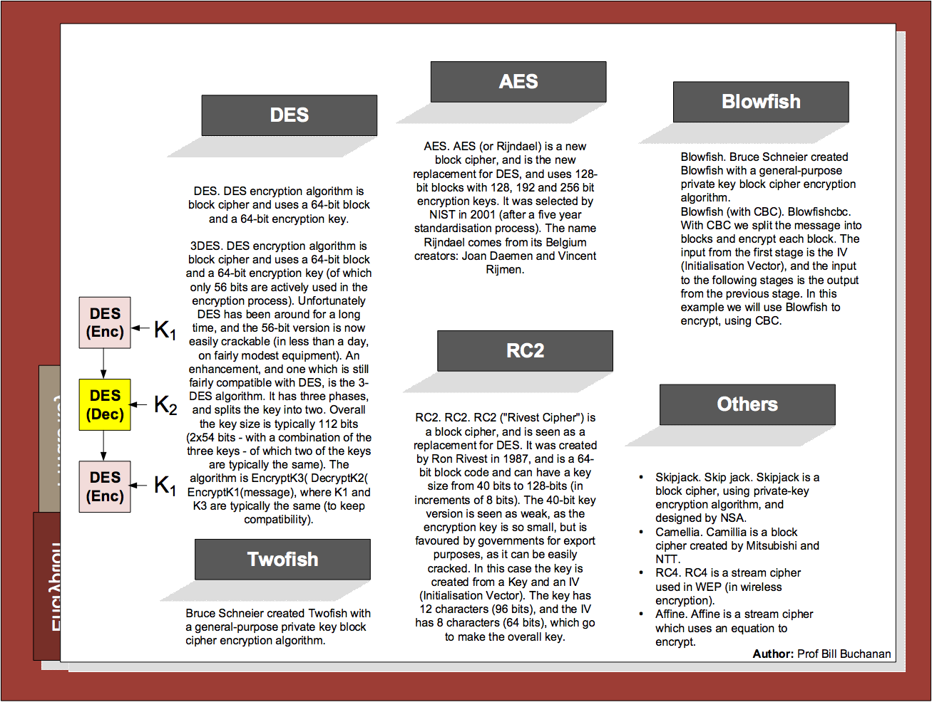

Slide 31
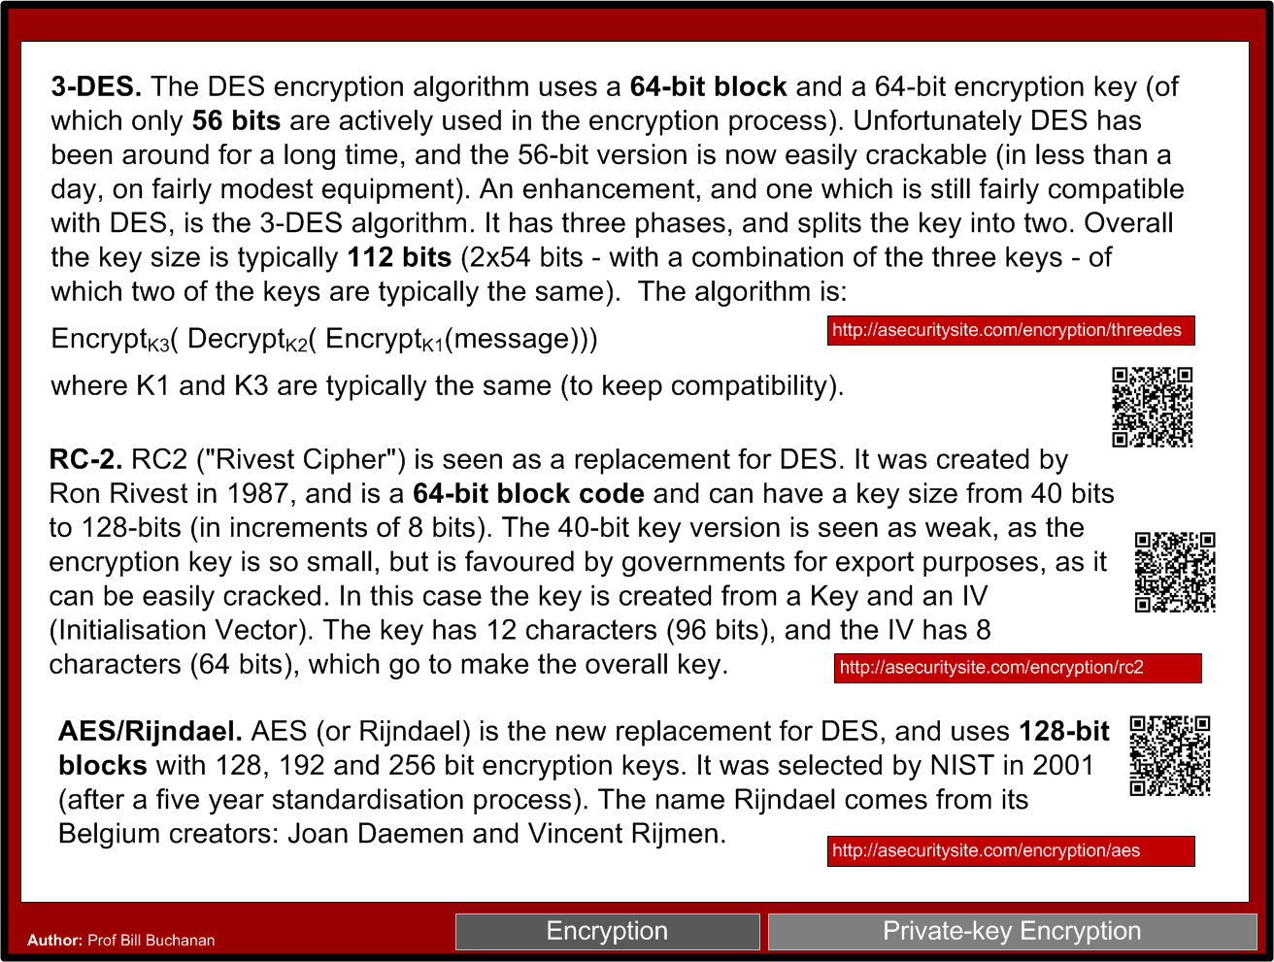

Slide 32


Slide 33
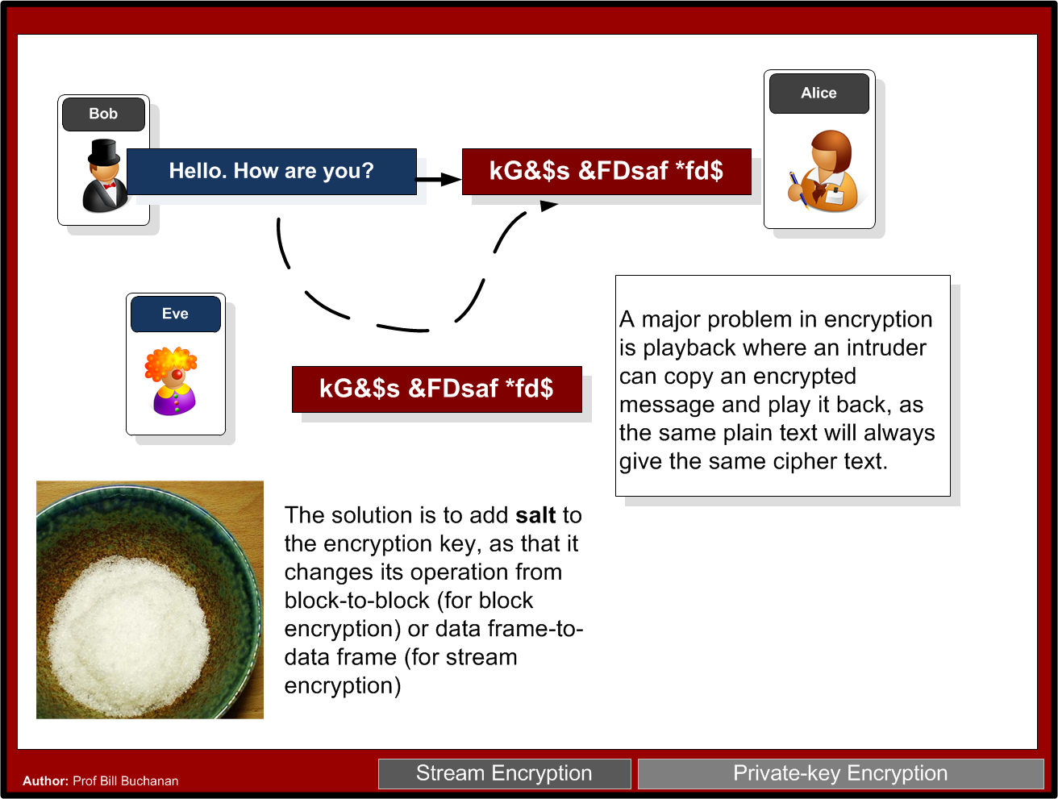

Slide 34
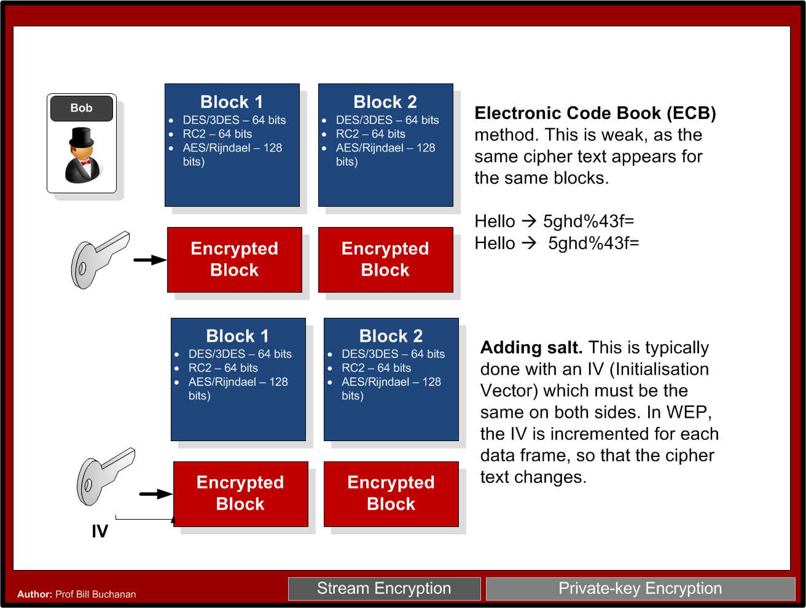

Slide 35
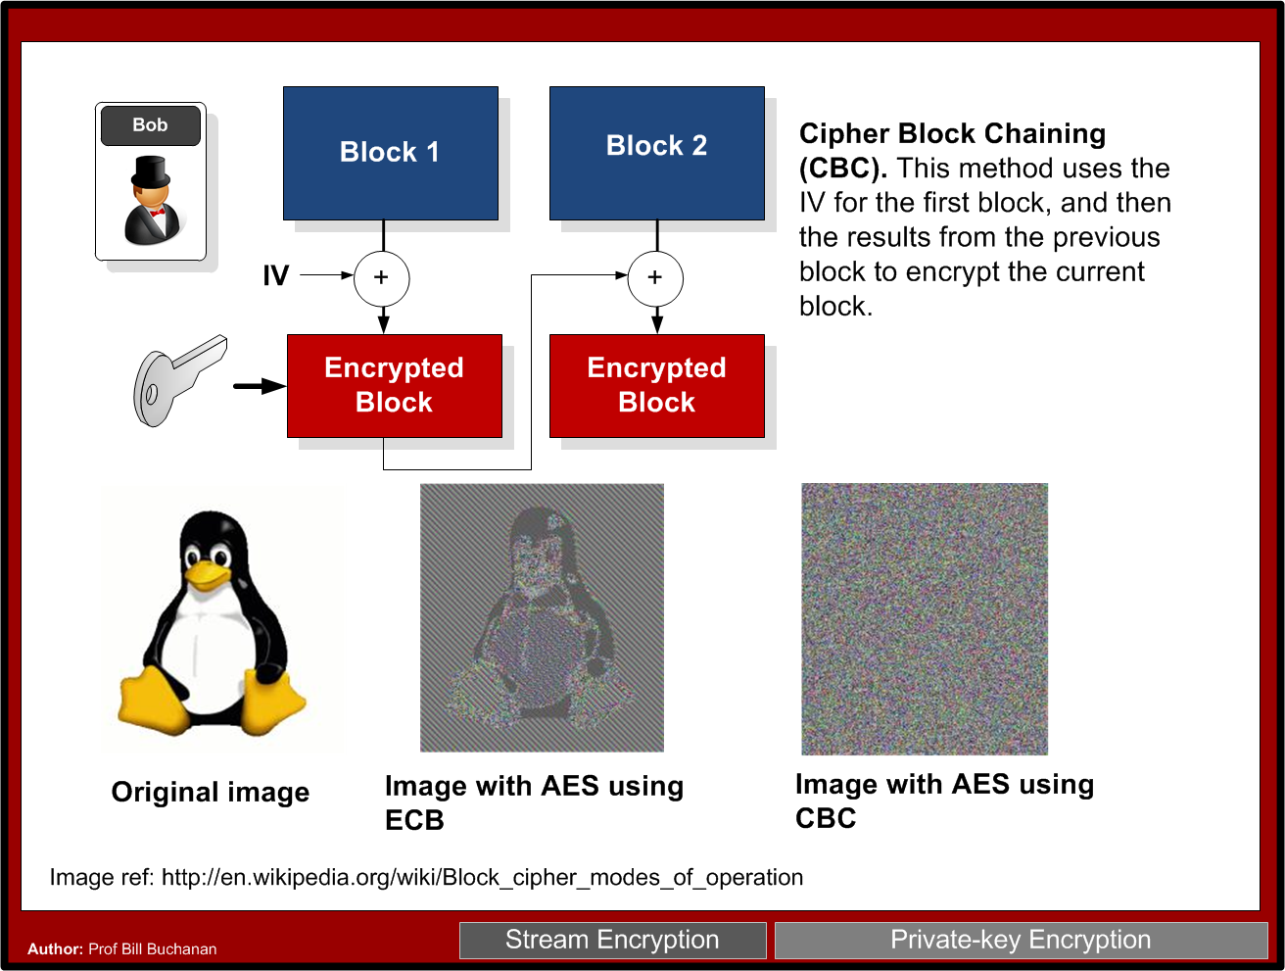

Slide 36
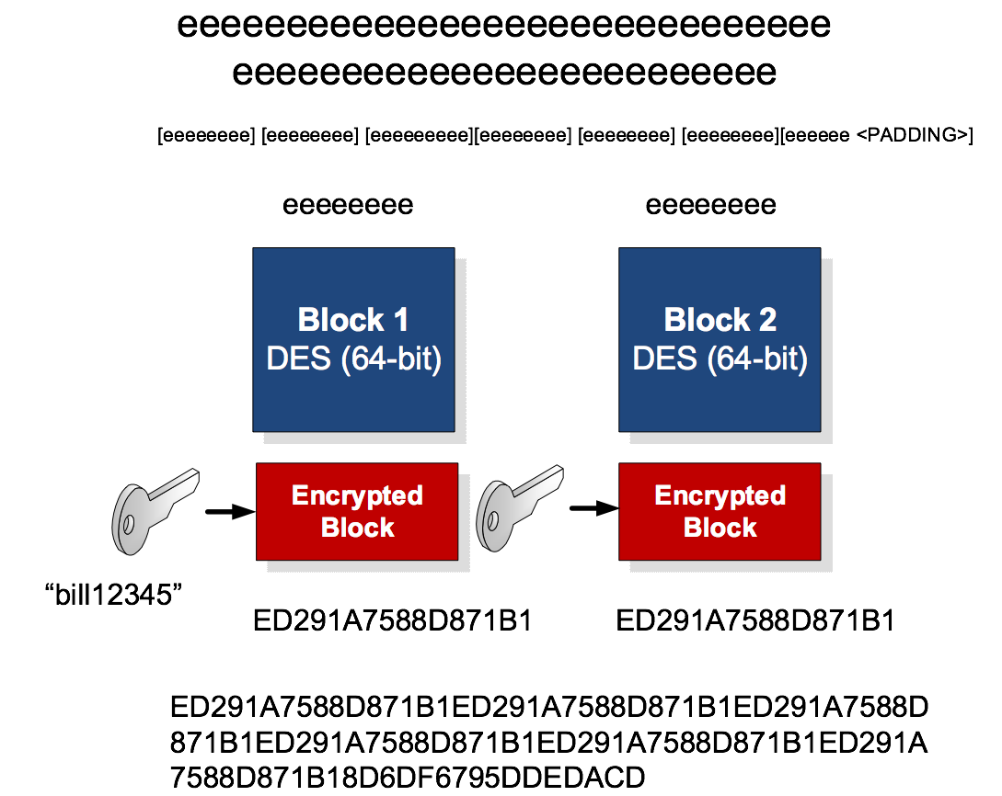

Slide 37
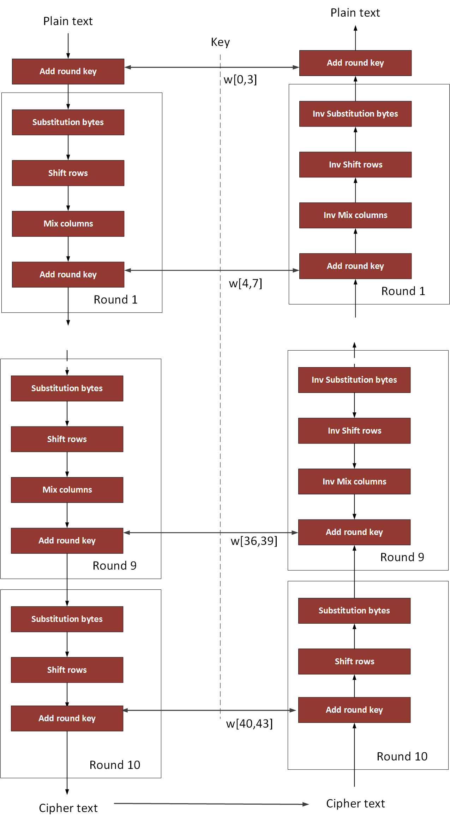
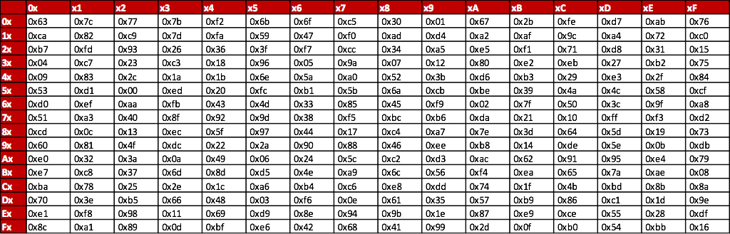
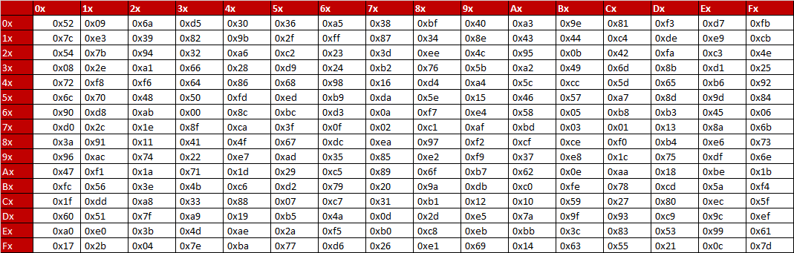
AES
NIST

Slide 38
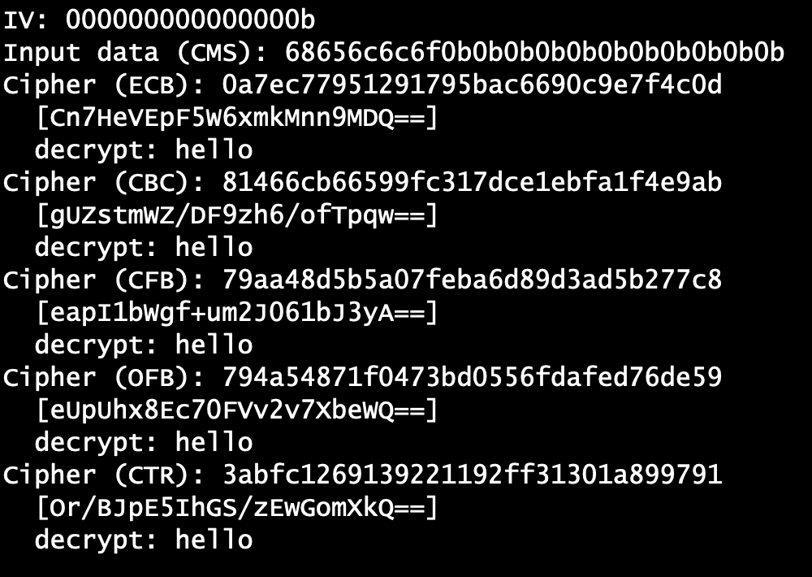
AES Modes
Example
ECB

Slide 39
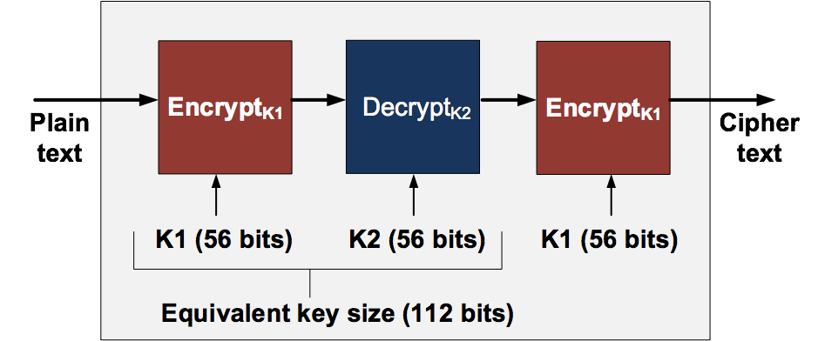
3-DES

Slide 40
2. Symmetric Key Basics Block or Stream? Secret Key Methods Salting AES 3DES
ChaCha20/Poly1305 and RC4 Key Entropy Prof Bill Buchanan OBE https://asecuritysite.com/encryption

Slide 41
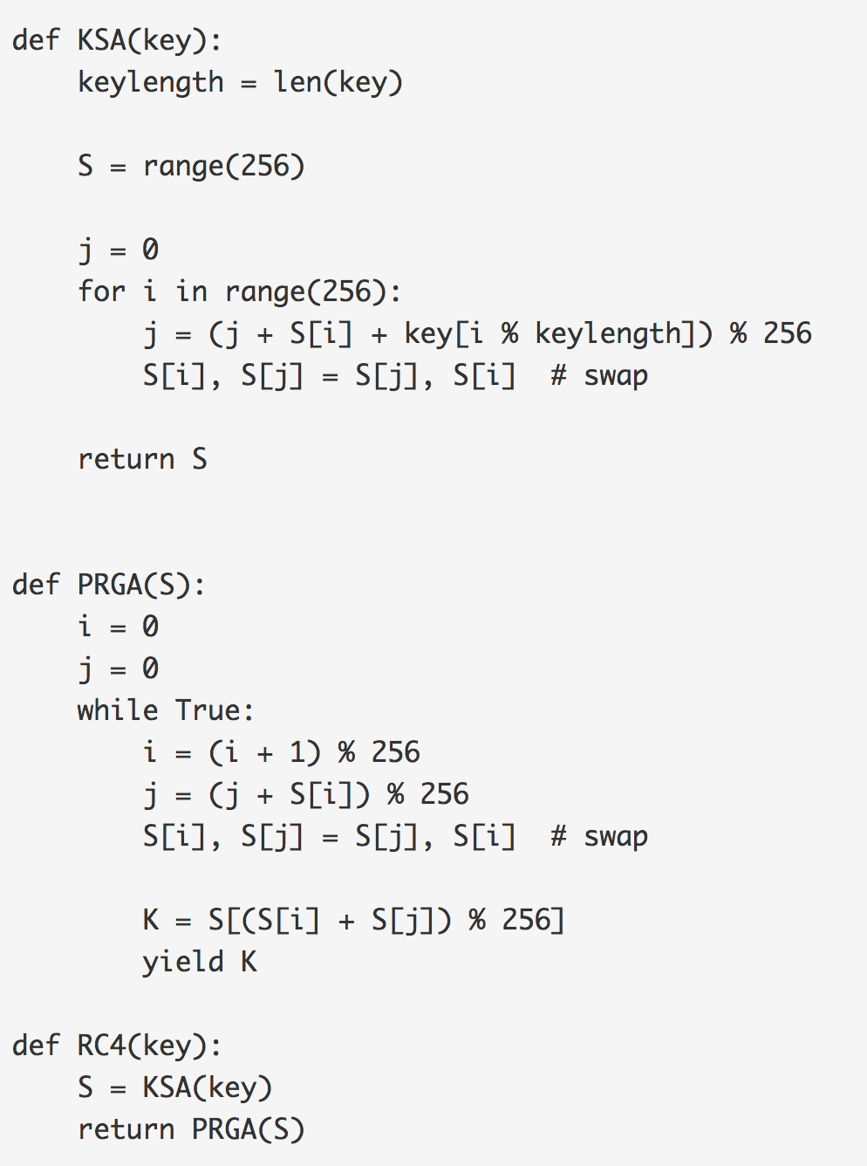
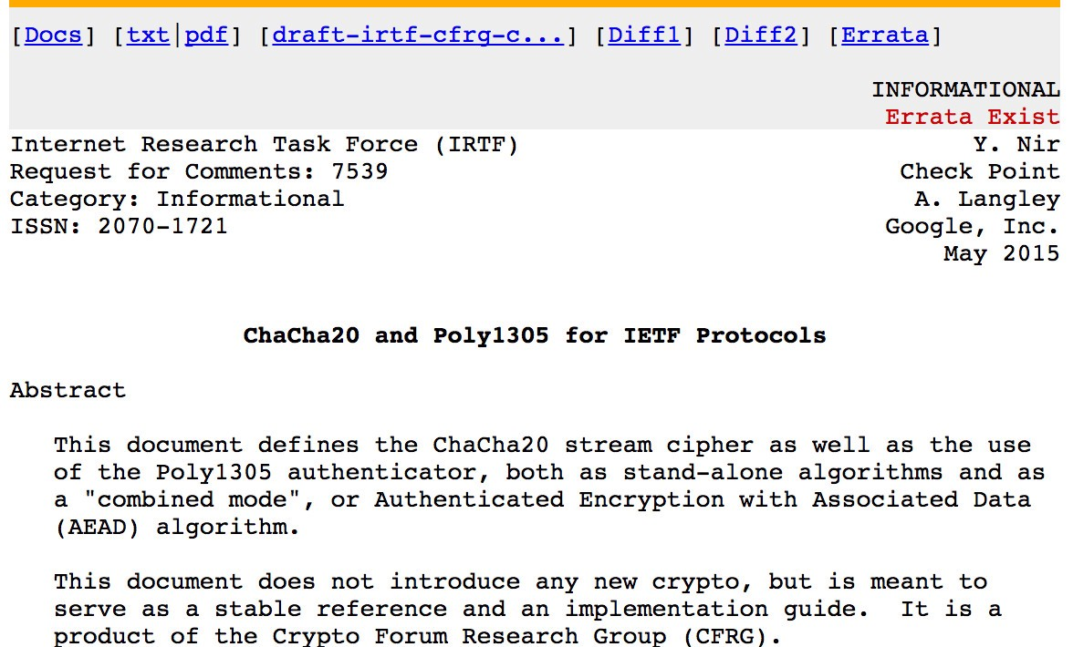
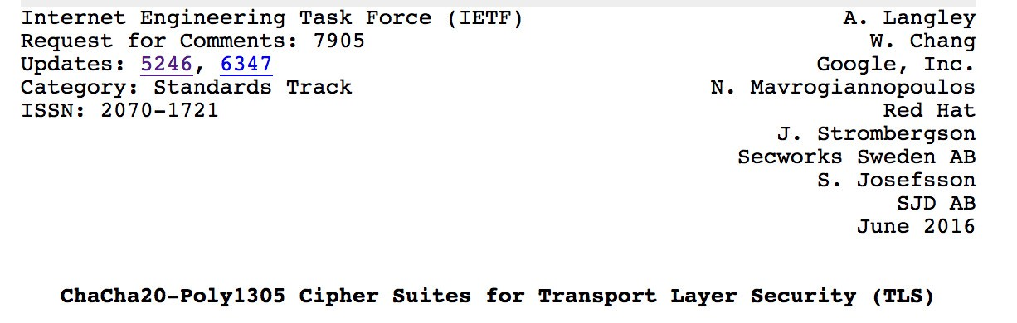
Try!
Try!
ChaCha20 and Salsa take a 256-bit key (or a 128-bit version) and a 32-bit nonce. This creates a key stream, which is then XORed with the plaintext stream. In software, it is more than three times faster than AES, and is well suited to lower-powered devices and in real-time communications.
ChaCha operates on 32-bit bits with a key of 256 bits (K=(k0, k1, k2, k3, k4, k5, k6, k7). This output blocks of 512-bits for the key stream (Z), and which is EX-ORed with the plaintext stream.

Slide 42
2. Symmetric Key Basics Block or Stream? Secret Key Methods Salting AES 3DES
ChaCha20/Poly1305 Key Entropy Prof Bill Buchanan OBE https://asecuritysite.com/symmetric

Slide 43
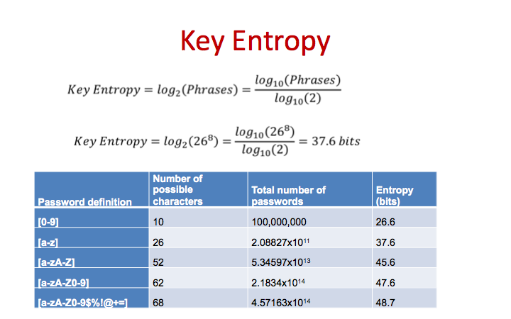
Try!

Slide 44
Chapter 3: Hashing Hashing Types. Hashing Methods. Salting. Collisions. LM and NTLM Hashes (Windows). Hash Benchmarks. Message Authentication Codes (MACs). OTP/HOTP. Hashcat (for practical work) Prof Bill Buchanan OBE https://asecuritysite.com/hash

Slide 45
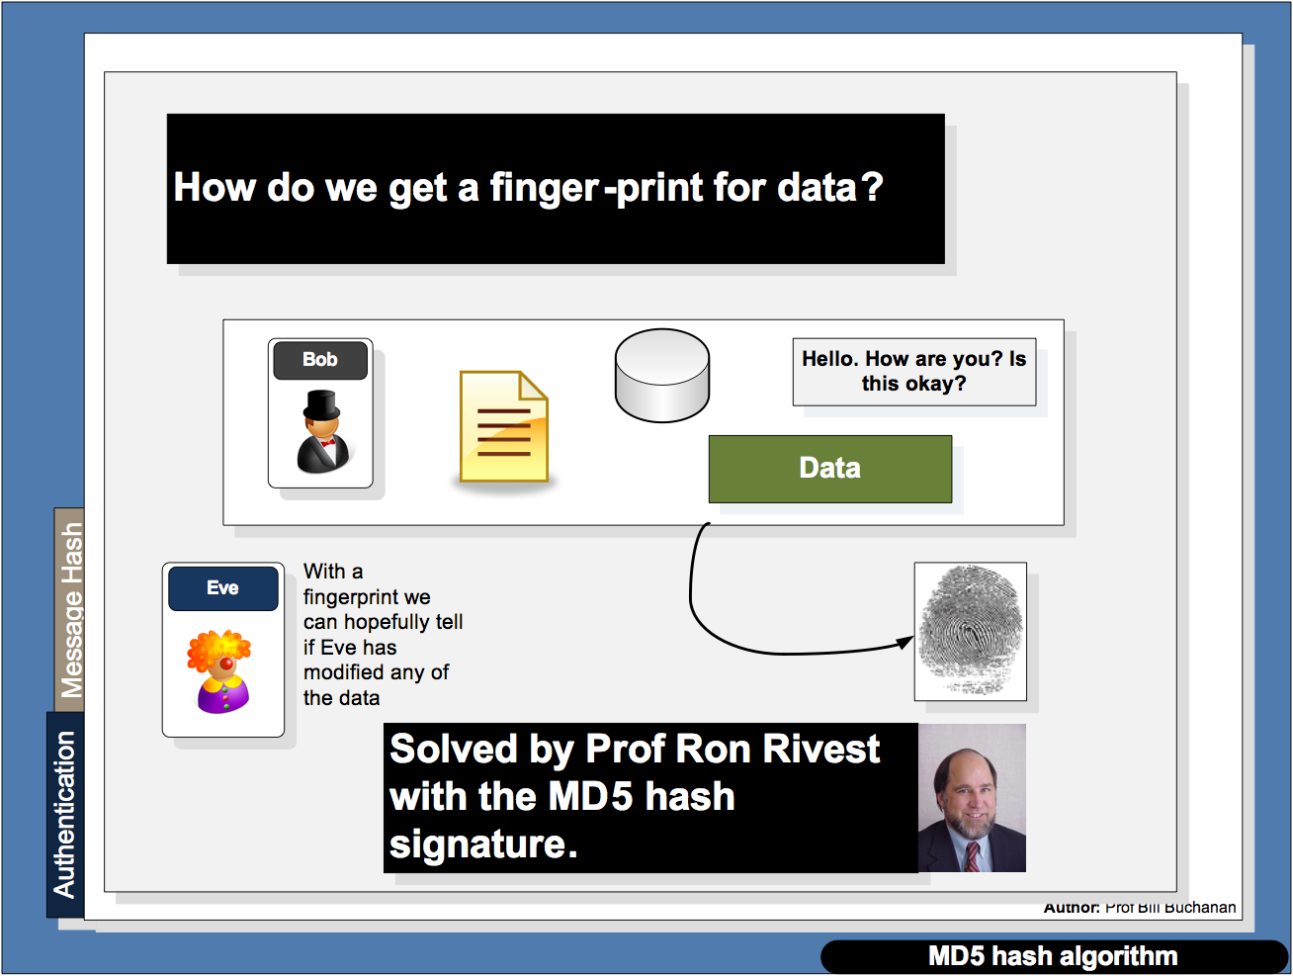

Slide 46
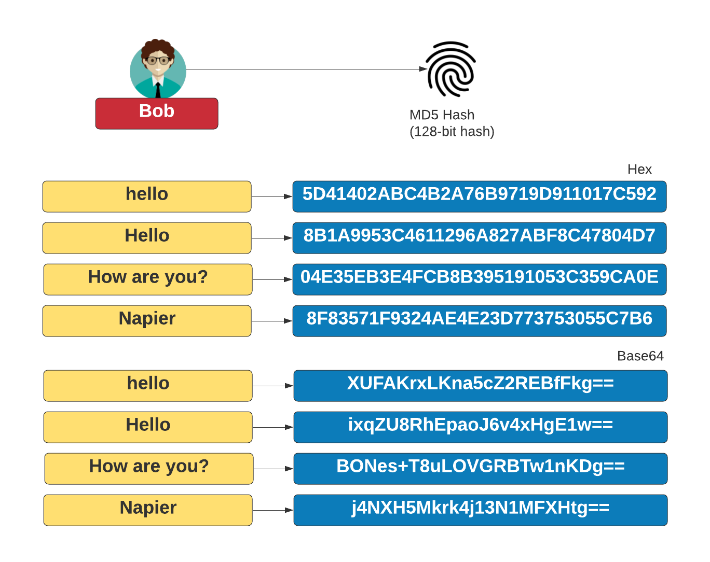

Slide 47
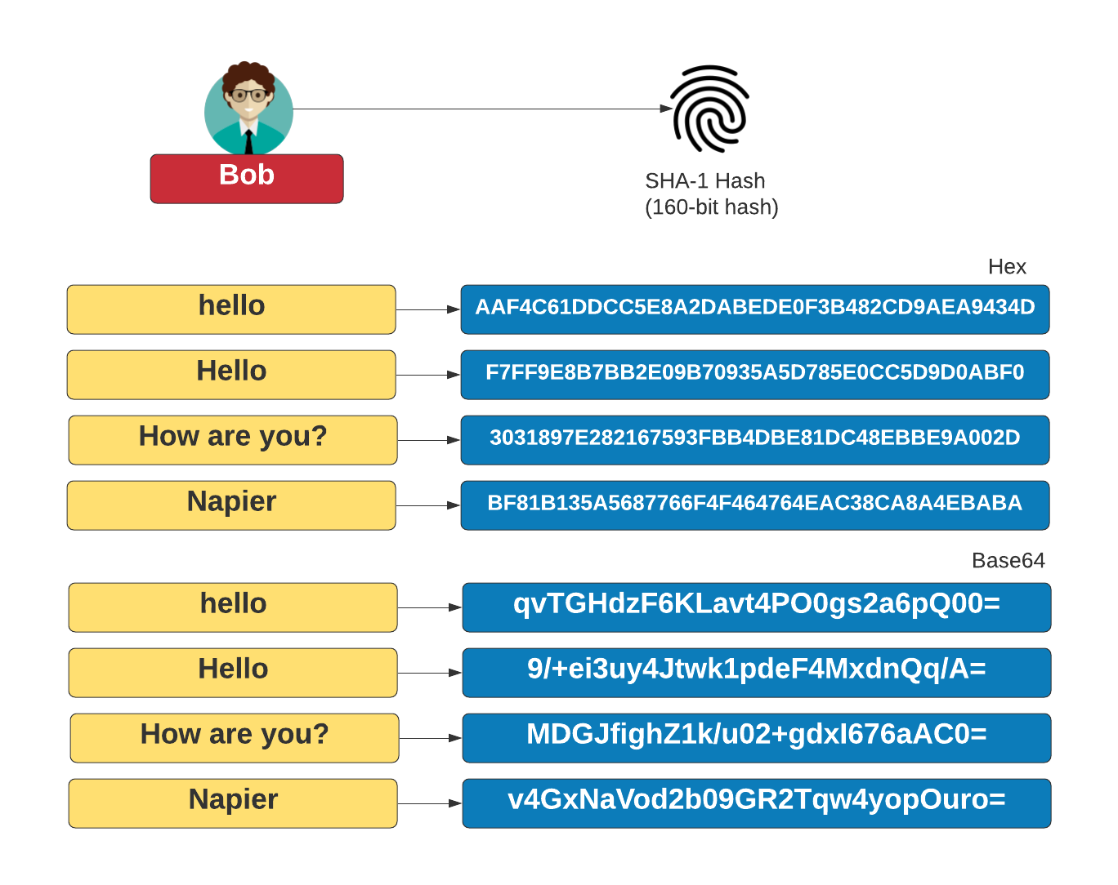

Slide 48
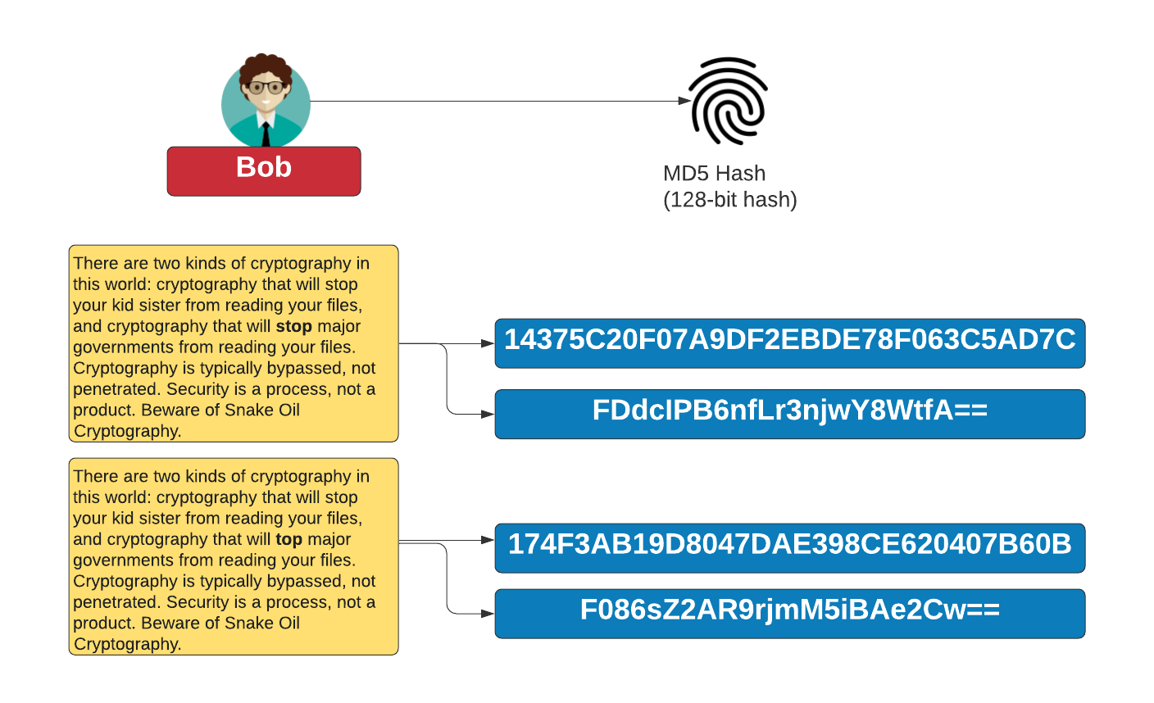

Slide 49
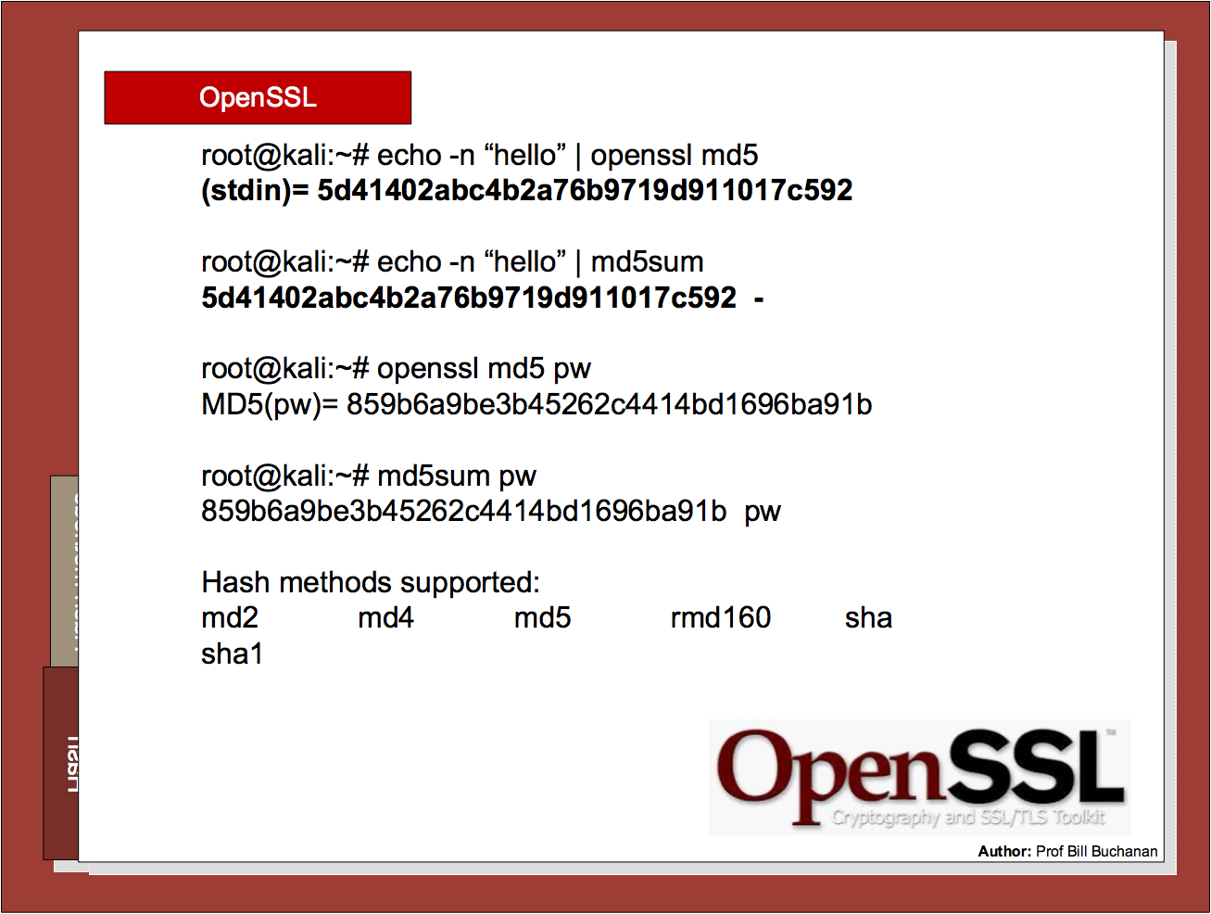

Slide 50
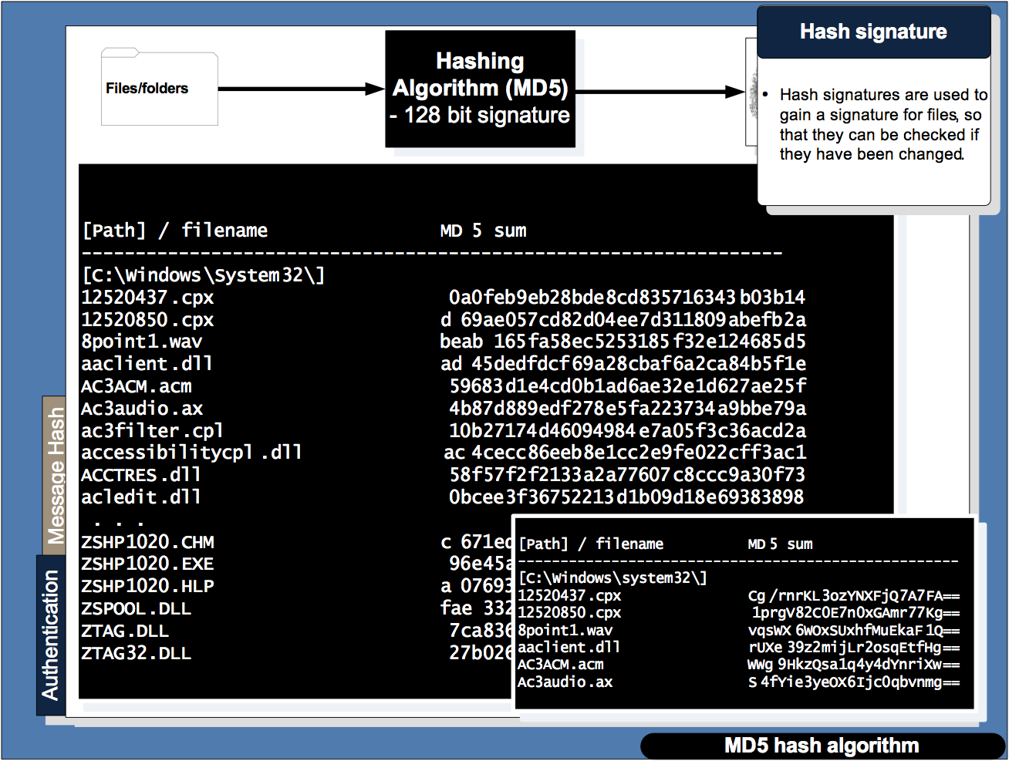

Slide 51
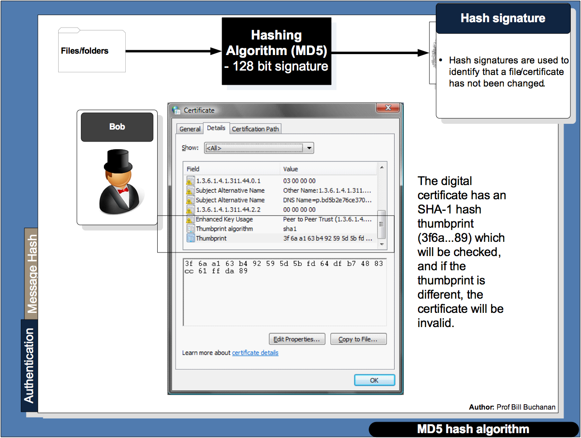

Slide 52
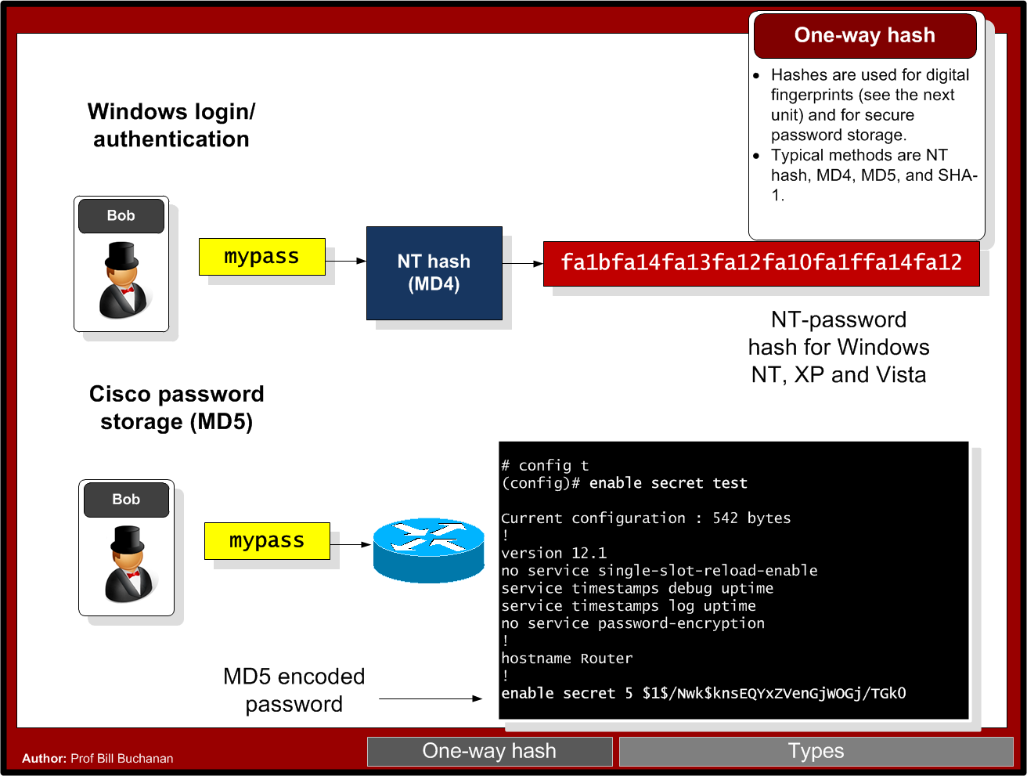

Slide 53
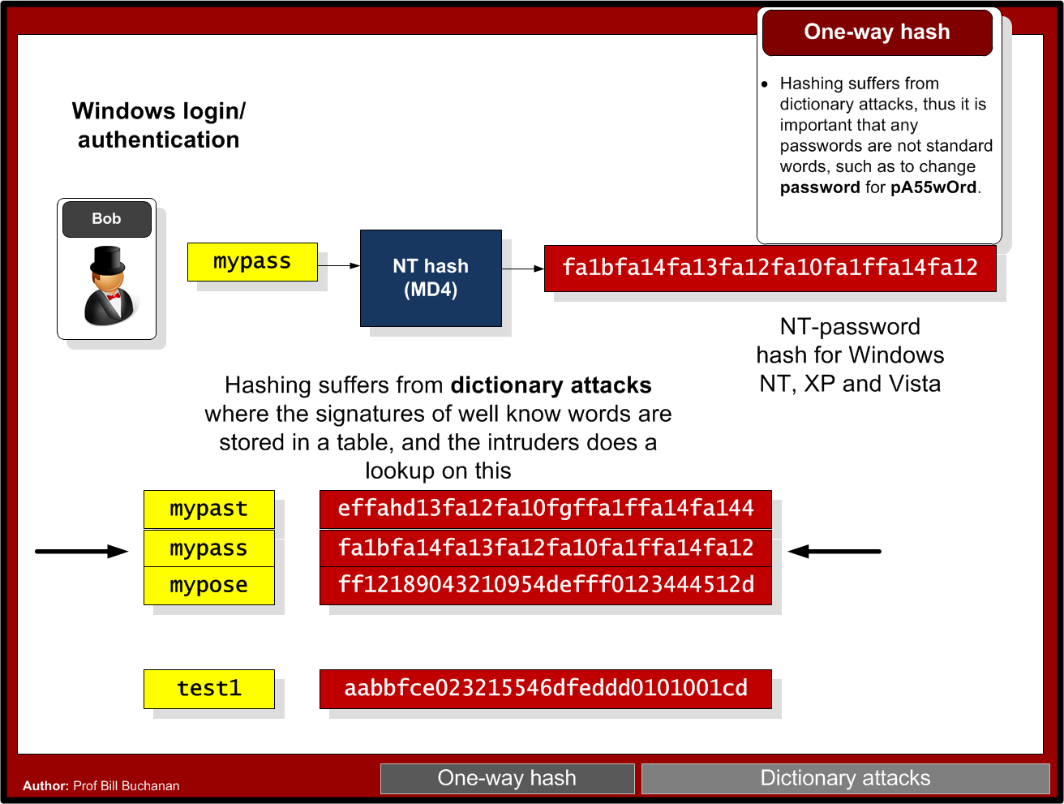

Slide 54
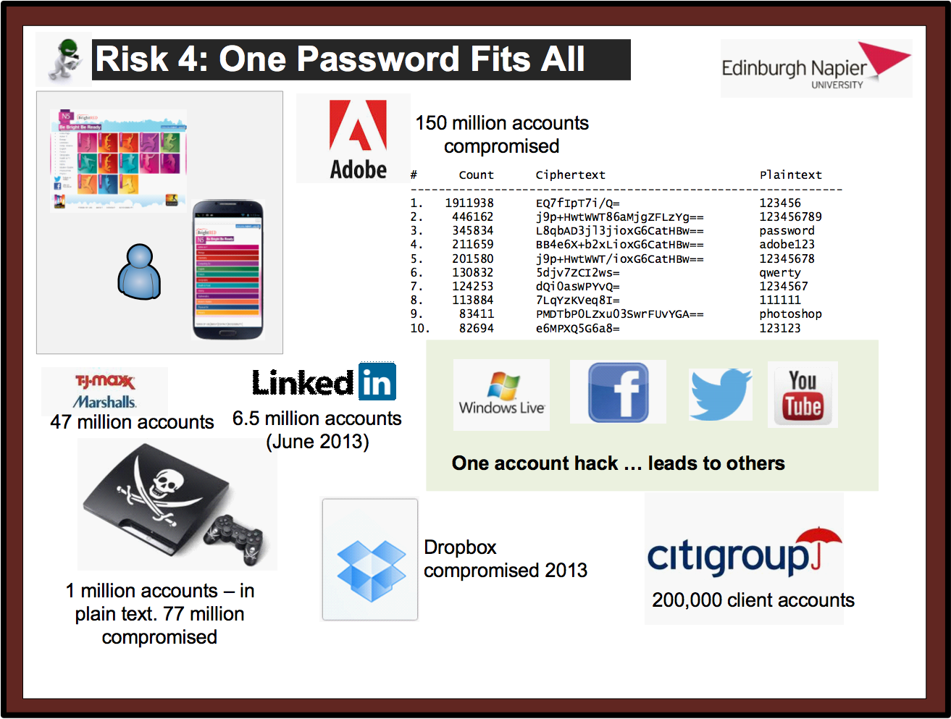

Slide 55
Brute Force - How many hash codes?
7 digit password with [a-z] … how many?
Ans:
Time to crack - 100 billion per second:
7 digit with [a-zA-z] … how many?
Ans:
Time to crack – 100 billion per second:
7 digit with [a-zA-z!@#$%^&*()] … how many?
Ans:
Time to crack – 100 billion per second:

Slide 56
Chapter 3: Hashing Hashing Types. Hashing Methods. Salting. Collisions. LM and NTLM Hashes (Windows). Hash Benchmarks. Message Authentication Codes (MACs). OTP/HOTP. Hashcat Prof Bill Buchanan OBE https://asecuritysite.com/hash

Slide 57
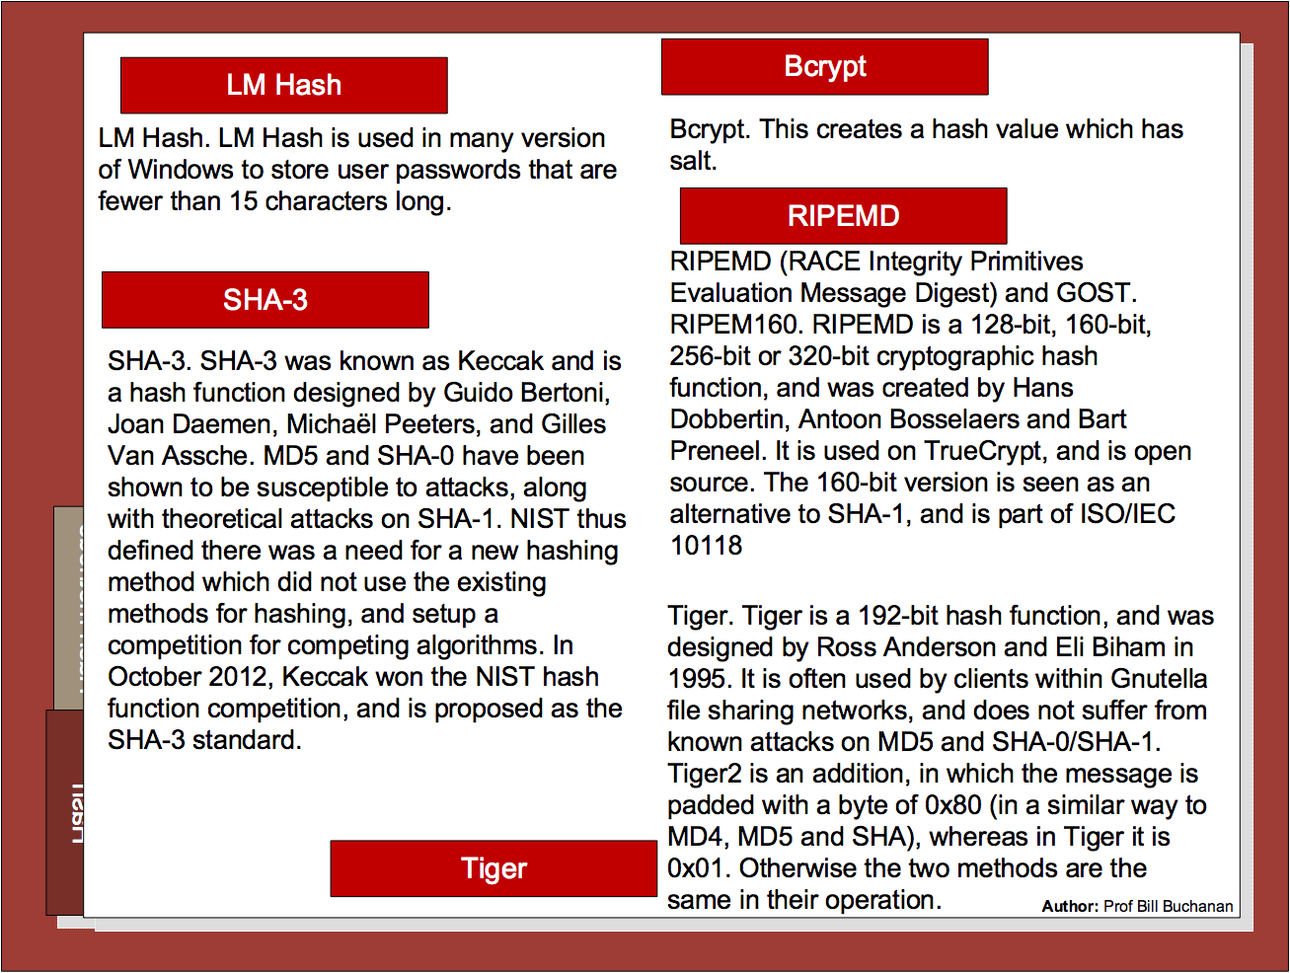

Slide 58
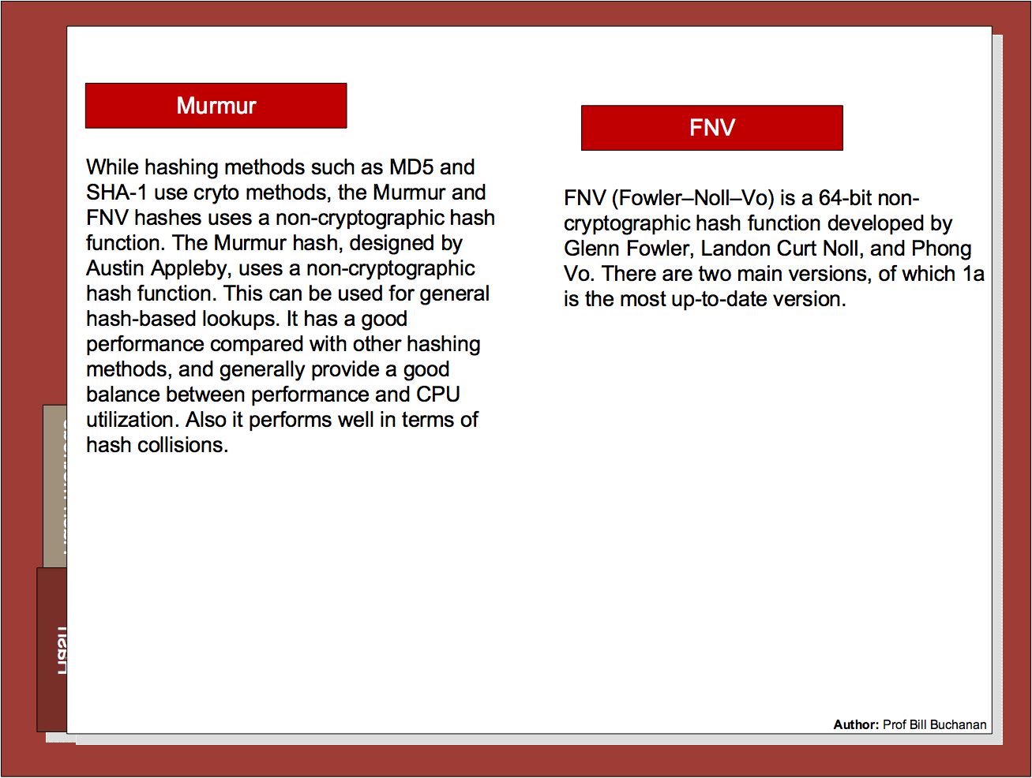

Slide 59
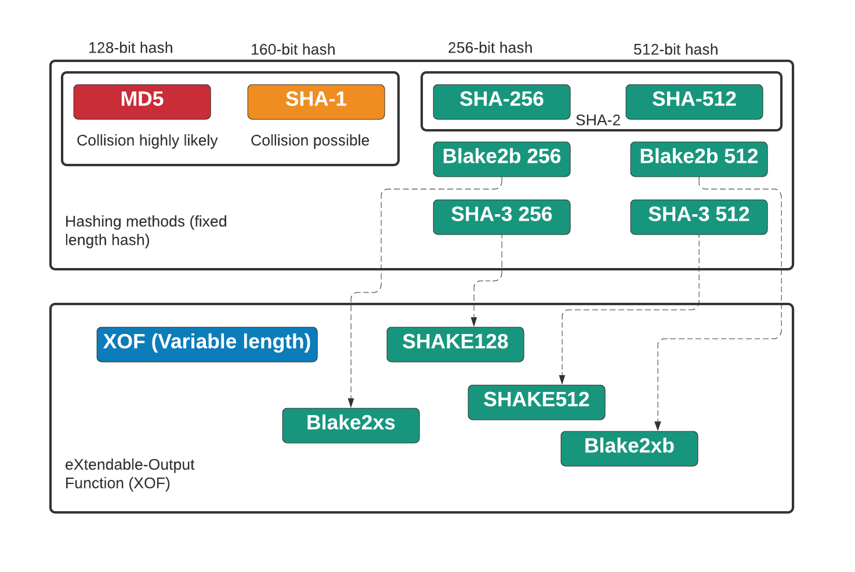

Slide 60
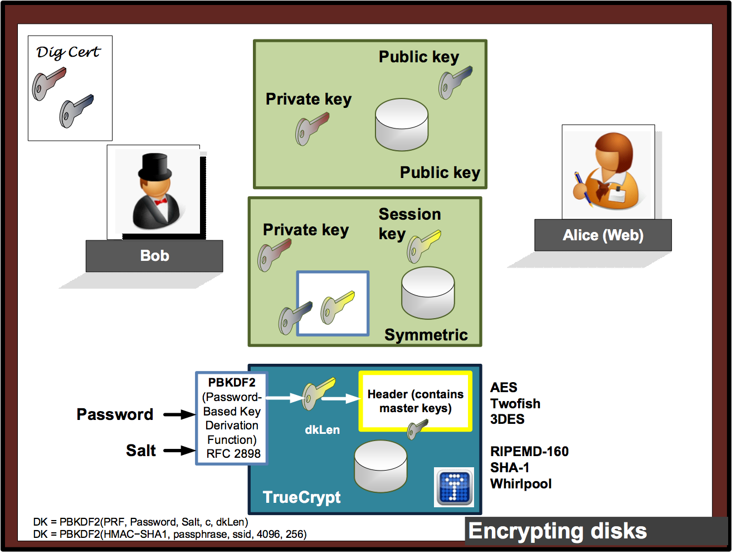

Slide 61

Chapter 3: Hashing Hashing Types. Hashing Methods. Salting. Collisions. LM and NTLM Hashes (Windows). Hash Benchmarks. Message Authentication Codes (MACs). OTP/HOTP. Secret Shares. Prof Bill Buchanan OBE http://asecuritysite.com/crypto03 http://asecuritysite.com/encryption

Slide 62
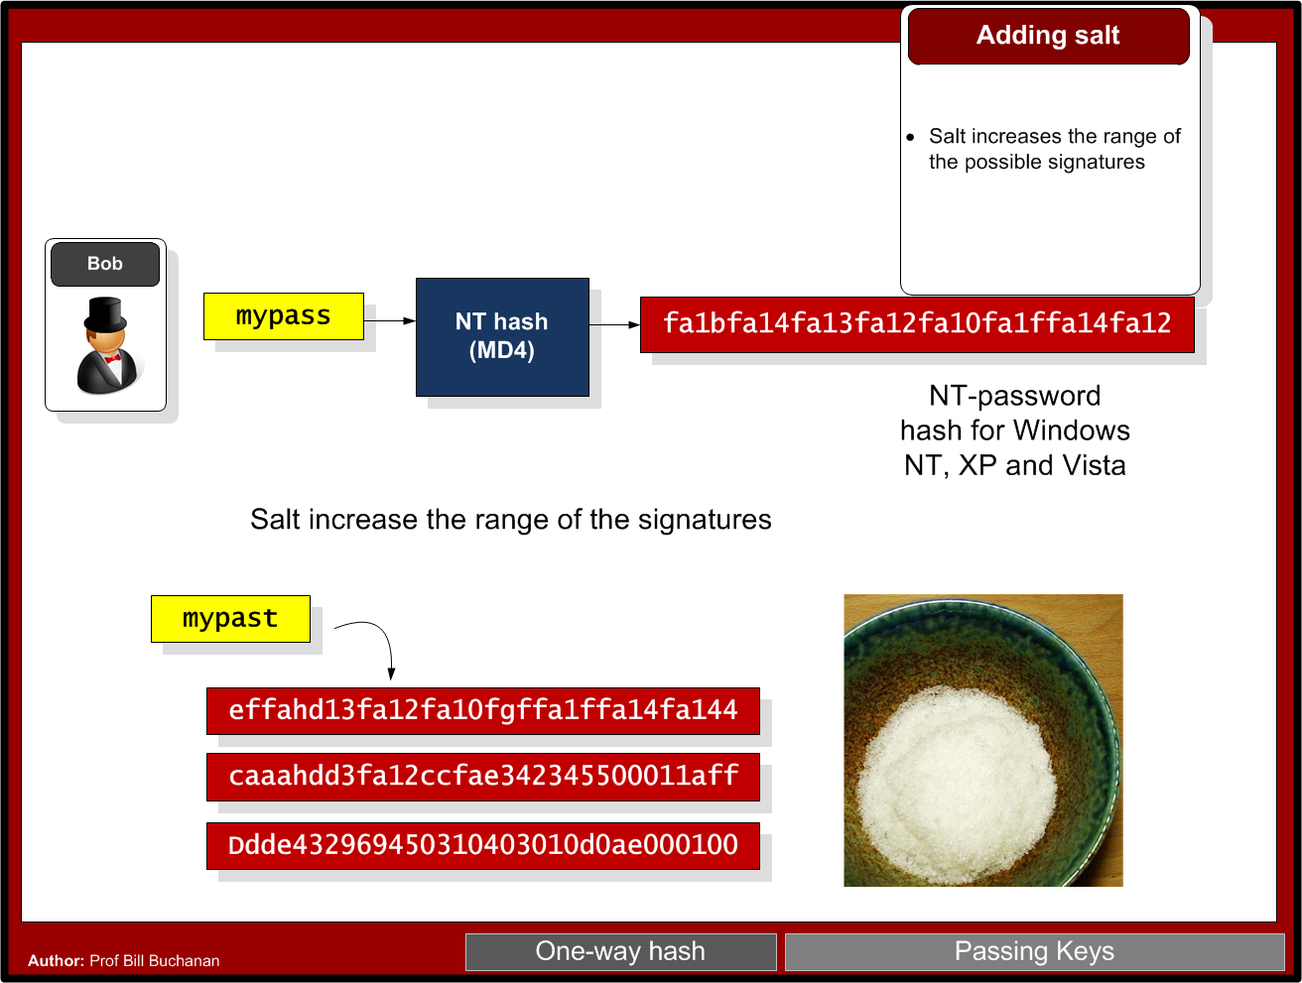

Slide 63


Slide 64


Slide 65
Chapter 3: Hashing Hashing Types. Hashing Methods. Salting. Collisions. LM and NTLM Hashes (Windows). Hash Benchmarks. Message Authentication Codes (MACs). OTP/HOTP. Hashcat. Prof Bill Buchanan OBE https://asecuritysite.com/hash

Slide 66


Slide 67


Slide 68

Nat McHugh
10 hours of computing on the Amazon GPU Cloud.
Cost: 60 cents
Used: Hashcat (on CUDA)
Birthday attack: A group size of only 70 people results in a 99.9% chance of two people sharing the same birthday.
M-bit output there are 2^m messages, and the same hash value would only require 2^(m/2) random messages. 18,446,744,073,709,551,616.
C:\openssl>openssl md5 hash01.jpg MD5(hash01.jpg)= e06723d4961a0a3f950e7786f3766338 C:\openssl>openssl md5 hash02.jpg MD5(hash02.jpg)= e06723d4961a0a3f950e7786f3766338

Slide 69
Chapter 3: Hashing Hashing Types. Hashing Methods. Salting. Collisions. LM and NTLM Hashes (Windows). Hash Benchmarks. Message Authentication Codes (MACs). OTP/HOTP. Hashcat. Prof Bill Buchanan OBE https://asecuritysite.com/hash

Slide 70


Slide 71


Slide 72


Slide 73


Slide 74



Hash Crackers/Bit Coin Miners
Fast Hash One
1.536TH/s – Cost 3-5,000 dollars.
25 GPU Hash Cracker
An eight character NTLM password cracked in 5.5 hours. 14 character LM hash cracked in six minutes. 350 billion hashes per second.

Slide 75
Chapter 3: Hashing Hashing Types. Hashing Methods. Salting. Collisions. LM and NTLM Hashes (Windows). Hash Benchmarks. Message Authentication Codes (MACs). OTP/HOTP. Hashcat. Prof Bill Buchanan OBE https://asecuritysite.com/hash

Slide 76

Benchmark
Hashes “The quick brown fox jumps over the lazy dog:
SHA-1: 2fd4e1c67a2d28fced849ee1bb76e7391b93eb12
SHA-256: d7a8fbb307d7809469ca9abcb0082e4f8d5651e46d3cdb762d02d0bf37c9e592
SHA-512: 07e547d9586f6a73f73fbac0435ed76951218fb7d0c8d788a309d7
85436bbb642e93a252a954f23912547d1e8a3b5ed6e1bfd7097821233fa0538f3db854fee6
MD-5: 9e107d9d372bb6826bd81d3542a419d6
DES: ZDeS94Lcq/6zg
Bcrypt: $2a$05$2czCv5GYgkx3aobmEyewB.ejV2hePMdbvTdCyNaSzWtlGPPjB2xx6
APR1: $apr1$ZDzPE45C$3PvRanPycmNc6c2G9wT9b/
PBKDF2 (SHA1): $pbkdf2$5$WkR6UEU0NUM$0RB2bimWrMY.EPYibpaBT2q3HFg
PBKDF2 (SHA-256): $pbkdf2-sha256$5$WkR6UEU0NUM$yrJz2oJix7uBJZwZ/50vWUgdE
I/i0ffqeU4obqC0pk4
LM Hash: a7b07f9948d8cc7f97c4b0b30cae500f
NT Hash: 4e6a076ae1b04a815fa6332f69e2e231
MS DCC: efa9778bbc94a7360f664eb7d7144725
LDAP (MD5): {MD5}9e107d9d372bb6826bd81d3542a419d6
LDAP (SHA1): {SHA}2fd4e1c67a2d28fced849ee1bb76e7391b93eb12
MS SQL 2000: 0x0100BF77CE595DCD1FC87A37B3DEBC27A8C97355CB96B8BAB
63E602662BA5D5D33B913E422499BE72FF3D9BB65DE
MySQL: *A4E4D26FD0C6455E23E2187C3AABE844332AA1B3
Oracle 10: 4CDA2299FCAD0499
Postgres (MD5): md5d44c15daa11770f25c5350f7e5408dd1
Cisco PIX: kGyKN5CqdFQ1qJUs
Cisco Type 7: 15260309443B3E2D2B3875200108010D41505640135E1B0E080
519574156401540035E460B594D1D53020B5C
Benchmark

Slide 77
Slowing a hash
To slow the hash, we can use rounds, where we continually hash for a number of rounds. In the following we use 5,000 rounds:
===Splunk hashed password===
User: Fred
Password: qwerty123
Salt: Uk8SVGLsBuSmD75R
===Hashed password Fred:$6$Uk8SVGLsBuSmD75R$Lhp5yjwRUAM.LbH5IIthZ1u0bAUdJwBvvccBshAvpFPiRn62EYeiKOaP8xh97aV4UaNfVykRZhUy/3ZOZd1oc.
root@kali:~# hashcat -b -m 1800
Initializing hashcat v0.49 with 1 threads and 32mb segment-size…
Device………..: Intel(R) Core(TM) i7–8850H CPU 2.60GHz
Instruction set..: x86_64
Number of threads: 1
Hash type: sha512crypt, SHA512(Unix)
Speed/sec: 454 words
root@kali:~# hashcat -b -m 0
Initializing hashcat v0.49 with 1 threads and 32mb segment-size…
Device: Intel(R) Core(TM) i7–8850H CPU 2.60GHz
Instruction set..: x86_64
Number of threads: 1
Hash type: MD5
Speed/sec: 17.33M words
SHA512-crypt

Slide 78

Hashing

Slide 79

HMAC

Slide 80
Chapter 3: Hashing Hashing Types. Hashing Methods. Salting. Collisions. LM and NTLM Hashes (Windows). Hash Benchmarks. Message Authentication Codes (MACs). OTP/HOTP. Hashcat. Prof Bill Buchanan OBE https://asecuritysite.com/hash

Slide 81


Slide 82
Hashcat
Rule-based Attacks. Define a rule of the password.
Dictionary Attacks. Search through a dictionary of common passwords.
Brute-Force Attacks. Search through
Attack modes: Brute-force, Combinator, Dictionary, Mask, Rule-based, Toggle-case and Hybrid.

Slide 83
Hashcat
* General:
-m, --hash-type=NUM Hash-type, see references below
-a, --attack-mode=NUM Attack-mode, see references below
* Benchmark:
-b, --benchmark Run benchmark
* Files:
-o, --outfile=FILE Define outfile for recovered hash
--outfile-format=NUM Define outfile-format for recovered hash, see references below
--show Show cracked passwords only (see --username)
* Resources:
-c, --segment-size=NUM Size in MB to cache from the wordfile
-n, --threads=NUM Number of threads
* Rules:
-r, --rules-file=FILE Rules-file use: -r 1.rule
-g, --generate-rules=NUM Generate NUM random rules
--generate-rules-func-min=NUM Force NUM functions per random rule min
--generate-rules-func-max=NUM Force NUM functions per random rule max
* Toggle-Case attack-mode specific:
--toggle-min=NUM Number of alphas in dictionary minimum
--toggle-max=NUM Number of alphas in dictionary maximum
* Mask-attack attack-mode specific:
--pw-min=NUM Password-length minimum
--pw-max=NUM Password-length maximum
* Permutation attack-mode specific:
--perm-min=NUM Filter words shorter than NUM
--perm-max=NUM Filter words larger than NUM
* Table-Lookup attack-mode specific:
-t, --table-file=FILE Table file
--table-min=NUM Number of chars in dictionary minimum
--table-max=NUM Number of chars in dictionary maximum
hashcat [options] hashfile [mask|wordfiles|directories]
hashcat -m 0 myhash myfile.txt -o output.txt

Slide 84
Hashcat
-a, --attack-mode=NUM
Attack Modes:
0 = Straight
1 = Combination
2 = Toggle-Case
3 = Brute-force
4 = Permutation
5 = Table-Lookup
6 = Prince
hashcat [options] hashfile [mask|wordfiles|directories]
hashcat -m 0 myhash myfile.txt -o output.txt

Slide 85
Hashcat
-a, --attack-mode=NUM
-m hash-type
* Hash types:
0 = MD5
10 = md5($pass.$salt)
20 = md5($salt.$pass)
30 = md5(unicode($pass).$salt)
40 = md5($salt.unicode($pass))
50 = HMAC-MD5 (key = $pass)
60 = HMAC-MD5 (key = $salt)
100 = SHA1
110 = sha1($pass.$salt)
120 = sha1($salt.$pass)
130 = sha1(unicode($pass).$salt)
140 = sha1($salt.unicode($pass))
150 = HMAC-SHA1 (key = $pass)
160 = HMAC-SHA1 (key = $salt)
200 = MySQL323
300 = MySQL4.1/MySQL5
400 = phpass, MD5(Wordpress), MD5(phpBB3), MD5(Joomla)
500 = md5crypt, MD5(Unix), FreeBSD MD5, Cisco-IOS MD5
900 = MD4
1000 = NTLM
1400 = SHA256
1410 = sha256($pass.$salt)
5500 = NetNTLMv1-VANILLA / NetNTLMv1-ESS
5600 = NetNTLMv2
5700 = Cisco-IOS SHA256
8900 = scrypt
9200 = Cisco $8$
10000 = Django (PBKDF2-SHA256)
hashcat [options] hashfile [mask|wordfiles|directories]
hashcat -m 0 myhash myfile.txt -o output.txt

